Slide 1
The Heat Equation on Fractals and other Discrete Domains
By: Martin D. Buck (with a great deal of help from Matt Begue)

Slide 2
Outline
Introduction to Fractals
  Contractions maps and the self-similar identity
The Graph Laplacian
The Heat Equation
  The Cycle Graph
  The Spectral Dimension of the Octagasket

Slide 3
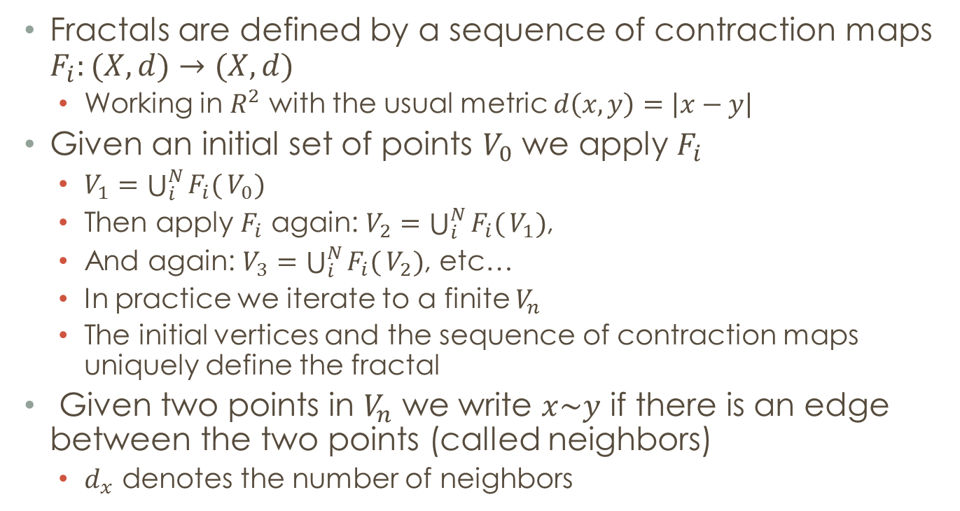
Introduction to Fractals
Fractals are defined by a sequence of contraction maps $F_{i}:(X,d)→(X,d)$
  Working in $R^{2}$ with the usual metric $d\left(x,y\right)=\left|x−y\right|$
Given an initial set of points $V_{0}$ we apply $F_{i}$
  $V_{1}=\bigcup_{i}^{N}{F_{i}(}V_{0})$
  Then apply $F_{i}$ again: $V_{2}=\bigcup_{i}^{N}{F_{i}(}V_{1})$,
  And again: $V_{3}=\bigcup_{i}^{N}{F_{i}(}V_{2})$, etc…
  In practice we iterate to a finite $V_{n}$
  The initial vertices and the sequence of contraction maps uniquely define the fractal
Given two points in $V_{n}$ we write $x\sim y$ if there is an edge between the two points (called neighbors)
  $d_{x}$ denotes the number of neighbors

Slide 4
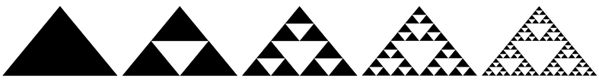
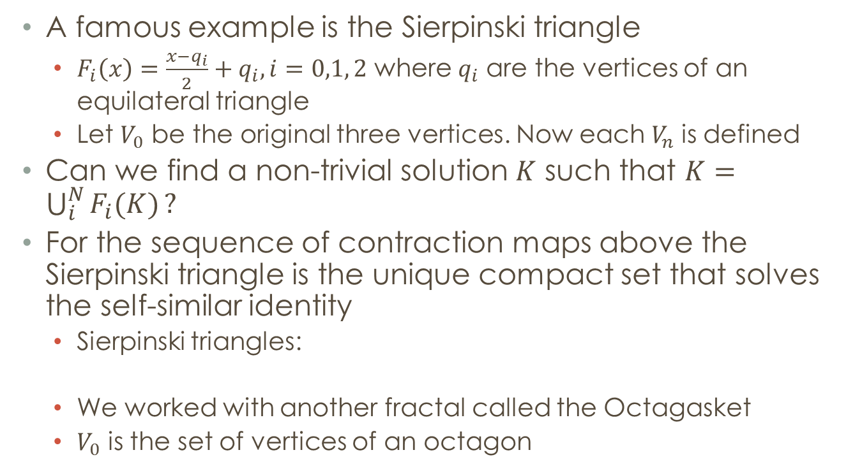
Introduction to Fractals
A famous example is the Sierpinski triangle
  $F_{i}\left(x\right)=\frac{x−q_{i}}{2}+q_{i}, i=0,1, 2$ where $q_{i}$ are the vertices of an equilateral triangle
  Let $V_{0}$ be the original three vertices. Now each $V_{n}$ is defined
Can we find a non-trivial solution $K$ such that $K=\bigcup_{i}^{N}{F_{i}(K)}?$
For the sequence of contraction maps above the Sierpinski triangle is the unique compact set that solves the self-similar identity
  Sierpinski triangles:
  We worked with another fractal called the Octagasket
  $V_{0}$ is the set of vertices of an octagon

Slide 5
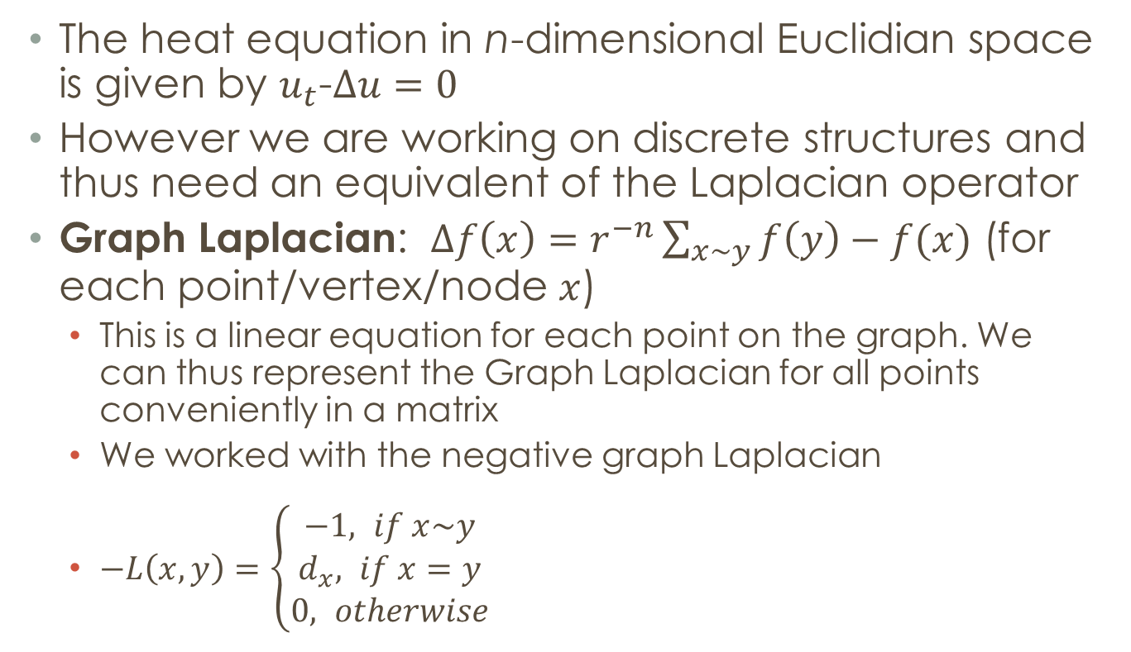
The Graph Laplacian
The heat equation in n-dimensional Euclidian space is given by $u_{t}$-$∆u=0$
However we are working on discrete structures and thus need an equivalent of the Laplacian operator
Graph Laplacian: $∆f\left(x\right)=$ $r^{−n}\sum_{x\sim y}{f\left(y\right)−f(x)}$ (for each point/vertex/node $x$)
  This is a linear equation for each point on the graph. We can thus represent the Graph Laplacian for all points conveniently in a matrix
  We worked with the negative graph Laplacian
  $−L\left(x,y\right)=\left\{\begin{aligned}−1, if x\sim y \\ d_{x}, if x=y \\ 0, otherwise\end{aligned}\right.$

Slide 6
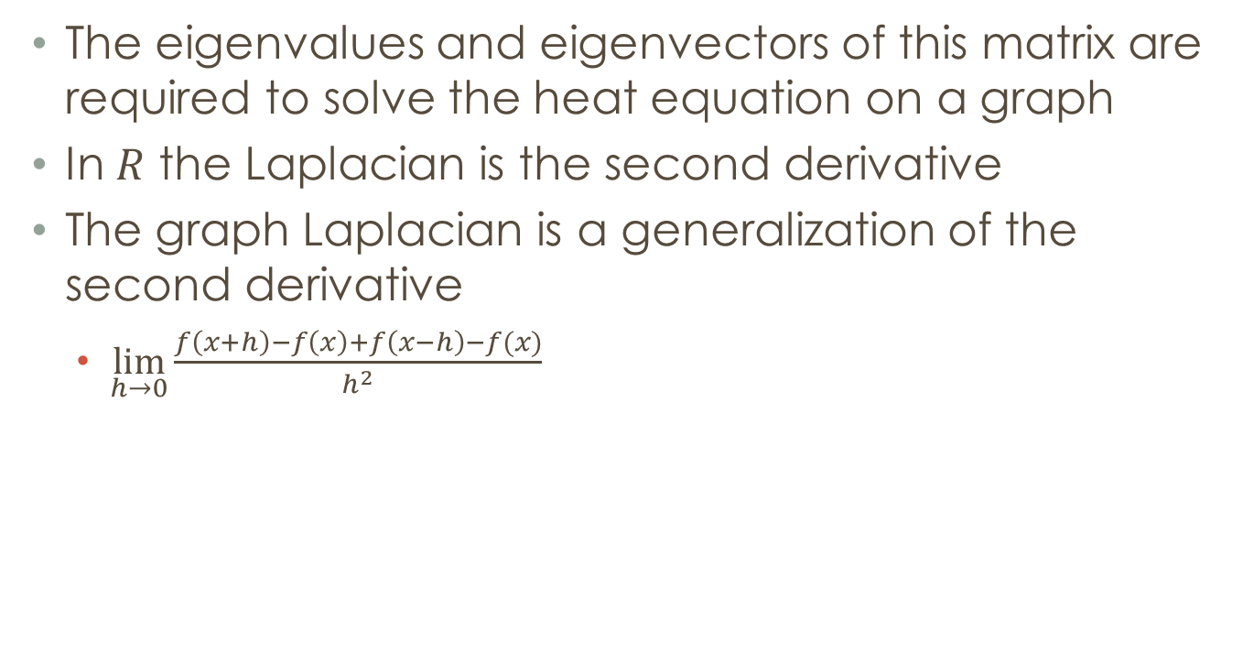
The Graph Laplacian
The eigenvalues and eigenvectors of this matrix are required to solve the heat equation on a graph
In $R$ the Laplacian is the second derivative
The graph Laplacian is a generalization of the second derivative
  $\lim_{h→0}{\frac{f\left(x+h\right)−f\left(x\right)+f\left(x−h\right)−f(x)}{h^{2}}}$

Slide 7
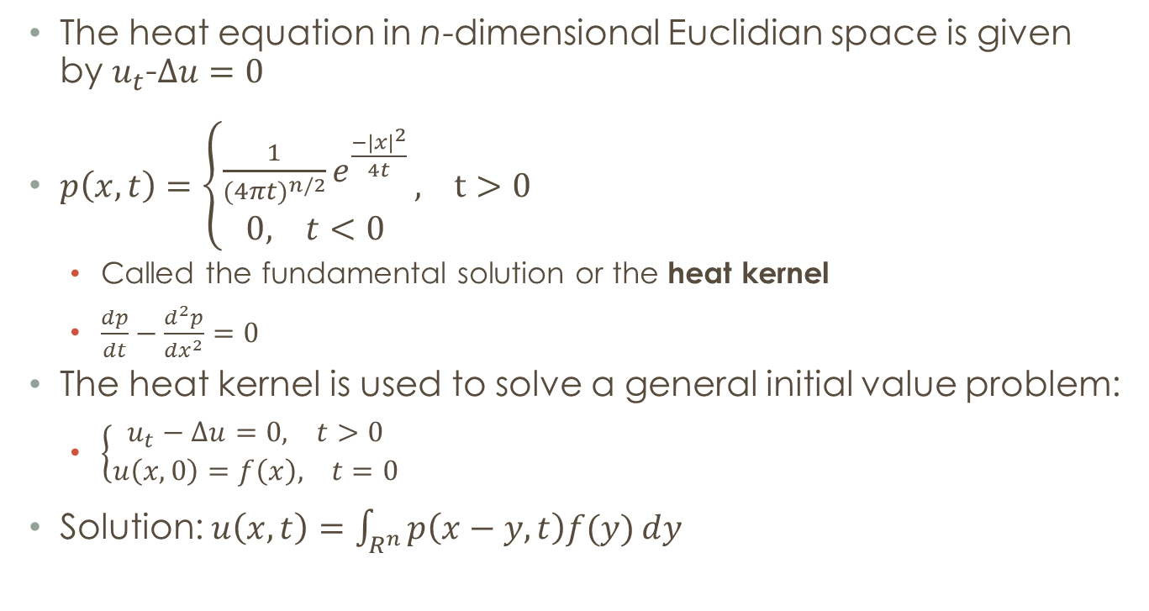
The Heat Equation
The heat equation in n-dimensional Euclidian space is given by $u_{t}$-$∆u=0$
$p\left(x,t\right)=\left\{\begin{aligned}\frac{1}{{(4πt)}^{n/2}}e^{\frac{{−|x|}^{2}}{4t}} \\ 0, t<0\end{aligned}\right., t>0$
  Called the fundamental solution or the heat kernel
  $\frac{dp}{dt}−\frac{d^{2}p}{dx^{2}}=0$
The heat kernel is used to solve a general initial value problem:
  $\left\{\begin{aligned}u_{t}−∆u=0, t>0 \\ u\left(x,0\right)=f\left(x\right), t=0\end{aligned}\right.$
Solution: $u\left(x,t\right)=\int_{R^{n}}{p\left(x−y,t\right)f(y)ⅆy}$

Slide 8
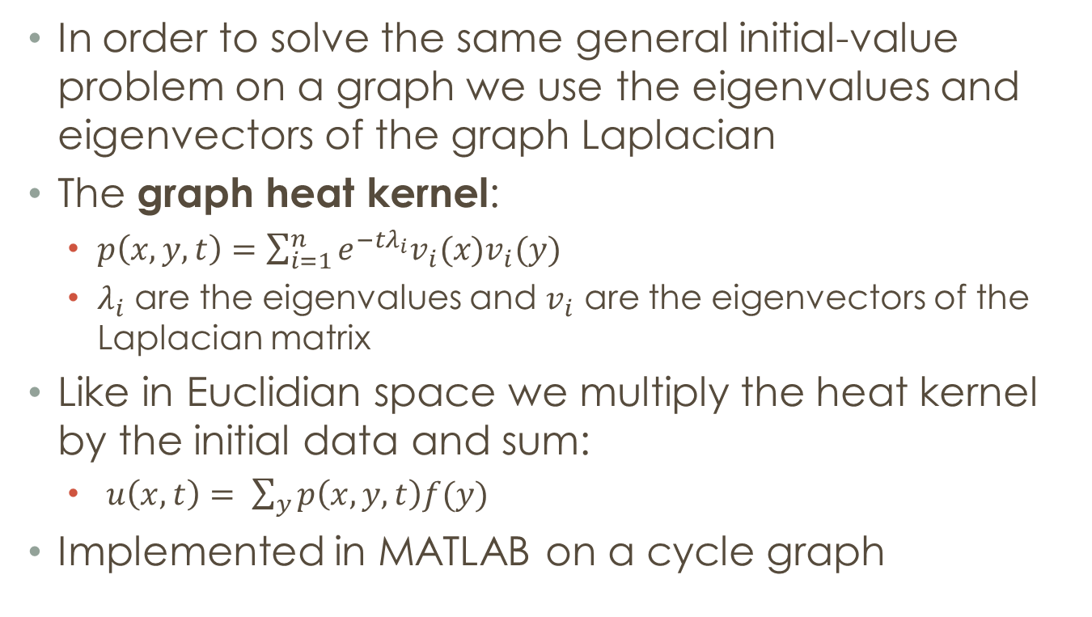
The Heat Equation on Graphs
In order to solve the same general initial-value problem on a graph we use the eigenvalues and eigenvectors of the graph Laplacian
The graph heat kernel:
  $p\left(x,y,t\right)=\sum_{i=1}^{n}{e^{−tλ_{i}}v_{i}(x)v_{i}(y)}$
  $λ_{i}$ are the eigenvalues and $v_{i}$ are the eigenvectors of the Laplacian matrix
Like in Euclidian space we multiply the heat kernel by the initial data and sum:
  $u\left(x,t\right)= \sum_{y}{p\left(x,y,t\right)f(y)}$
Implemented in MATLAB on a cycle graph

Slide 9
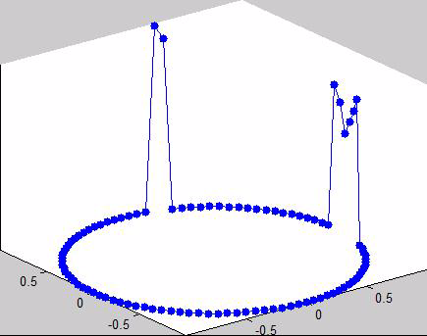
The Heat Equation on a Cycle Graph

Slide 10
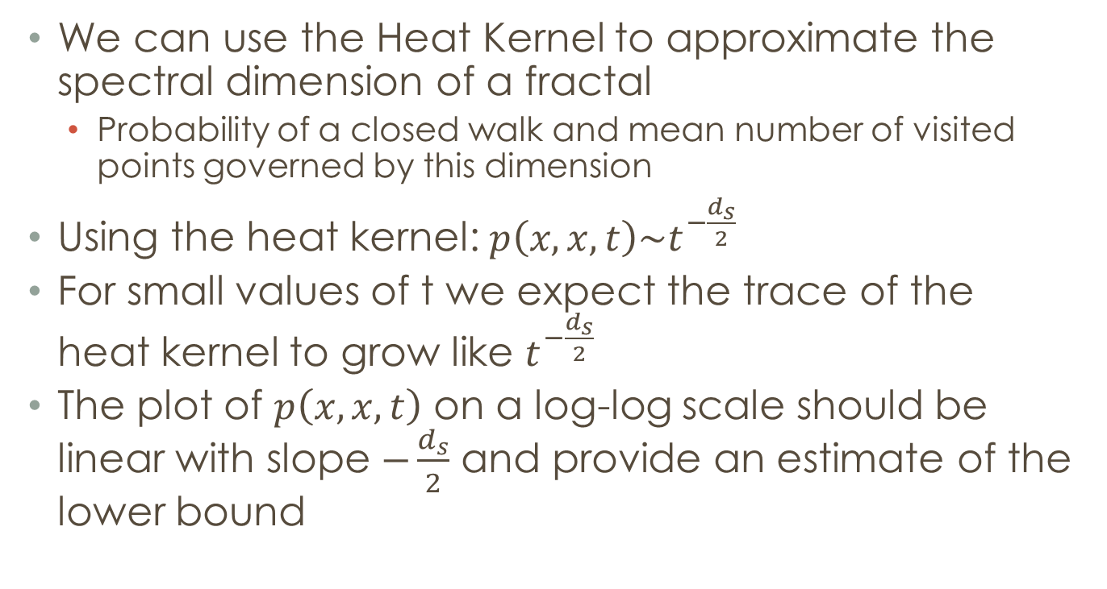
Heat Kernel AsymptoticS
We can use the Heat Kernel to approximate the spectral dimension of a fractal
  Probability of a closed walk and mean number of visited points governed by this dimension
Using the heat kernel: $p\left(x,x,t\right)\sim t^{−\frac{d_{s}}{2}}$
For small values of t we expect the trace of the heat kernel to grow like $t^{−\frac{d_{s}}{2}}$
The plot of $p\left(x,x,t\right)$ on a log-log scale should be linear with slope $−\frac{d_{s}}{2}$ and provide an estimate of the lower bound

Slide 11
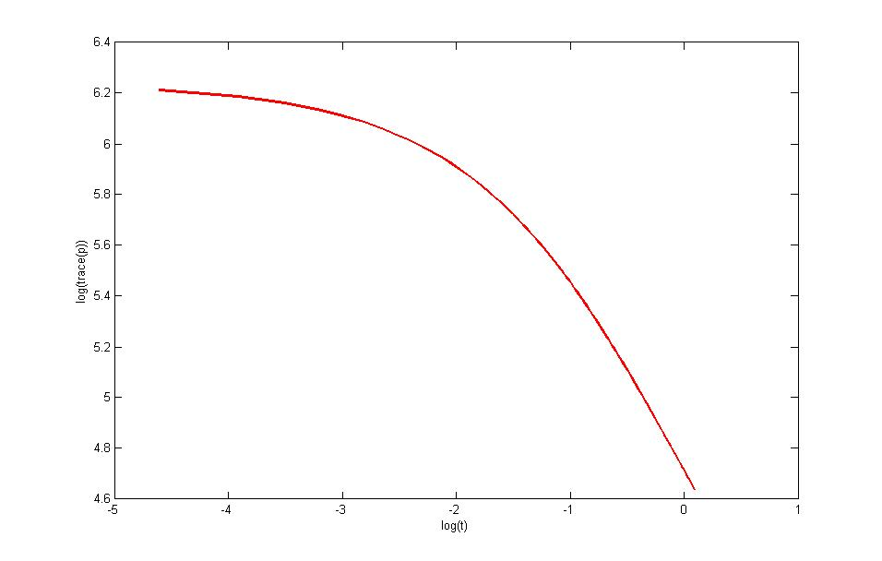
Heat Kernel Asymptotics

Slide 12

Heat Kernel Asymptotics
From fitting a line to the linear part of the curve: $d_{s}=1.430$ (Octagasket)
This is very close to the upper bound found by Berry, Heilman, and Strichartz ($d_{s}=1.43876$)

