Slide 1
Limit Fractals of Kleinian Groups
By Adam Anderson

Slide 2
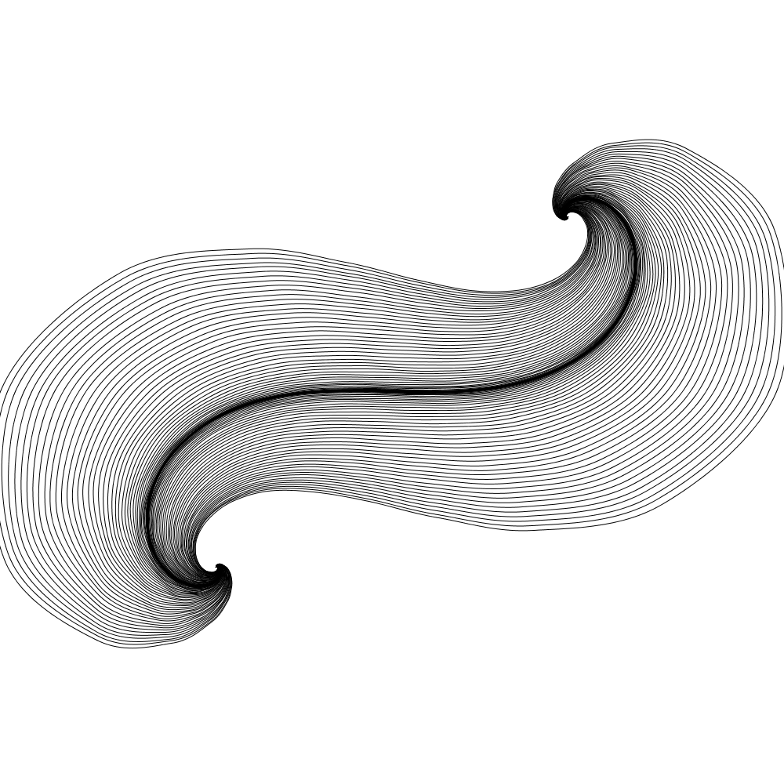
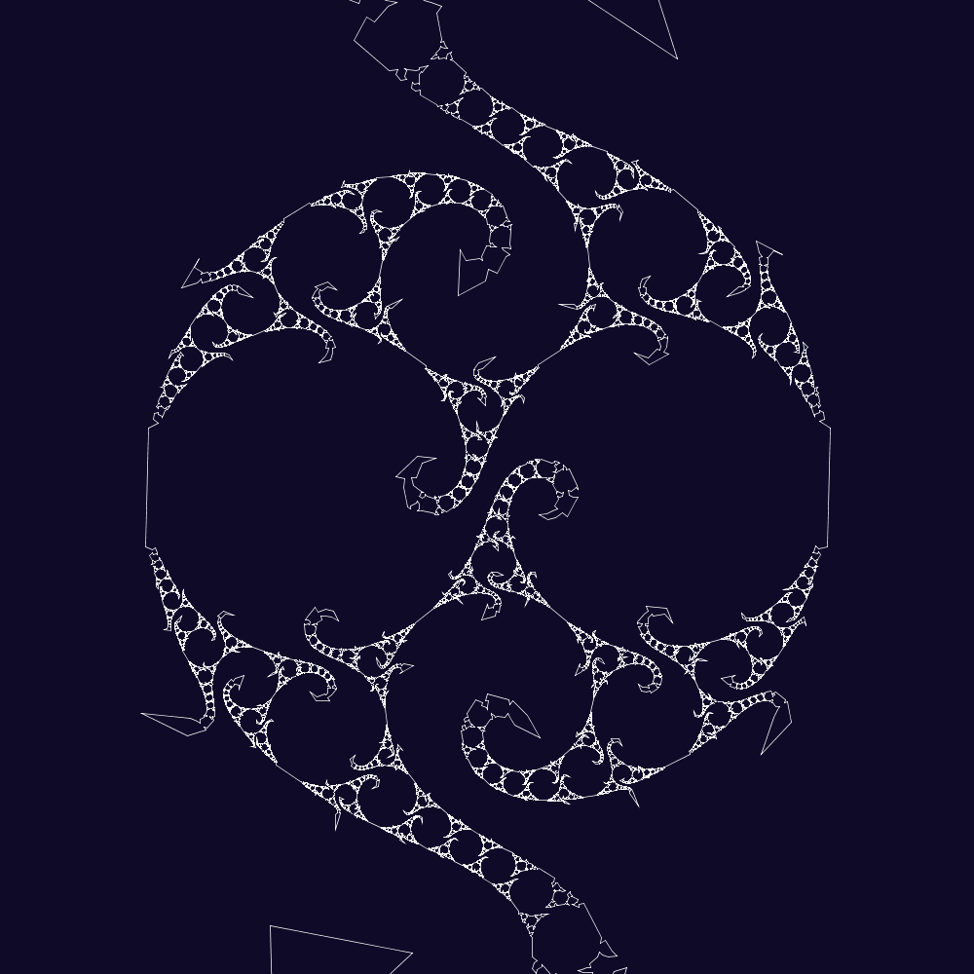
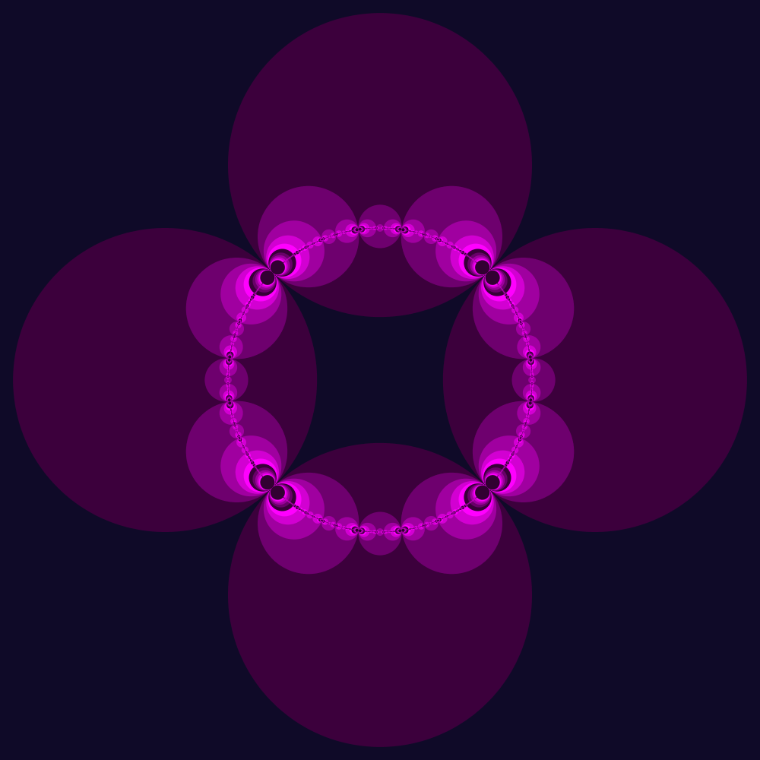
Agenda
Transformations
Mobius Maps
Kleinian Groups
Schottky Circles
Limit Sets

Slide 3
Transformations
Consider transformations of the complex plane:
Translation: $T\left(z\right)=z+b$
Rotation and Scaling: $R\left(z\right)=az$
Inversion: $I\left(z\right)=\frac{1}{z}$
Shift the origin
Rotate and scale the plane
Switch the origin and infinity

Slide 4
Inversion: $I\left(z\right)=\frac{1}{z}$

Slide 5
Möbius Maps
What if we want to combine these transformations?
Möbius maps allow us to move infinity and the origin to wherever we want!
$$M=\left(\begin{matrix}a & b \\ c & d\end{matrix}\right)$$
Matrix notation is useful because $M\left(N\left(z\right)\right)=(MN)(z)$
$$M\left(z\right)=\frac{az+b}{cz+d}$$

Slide 7
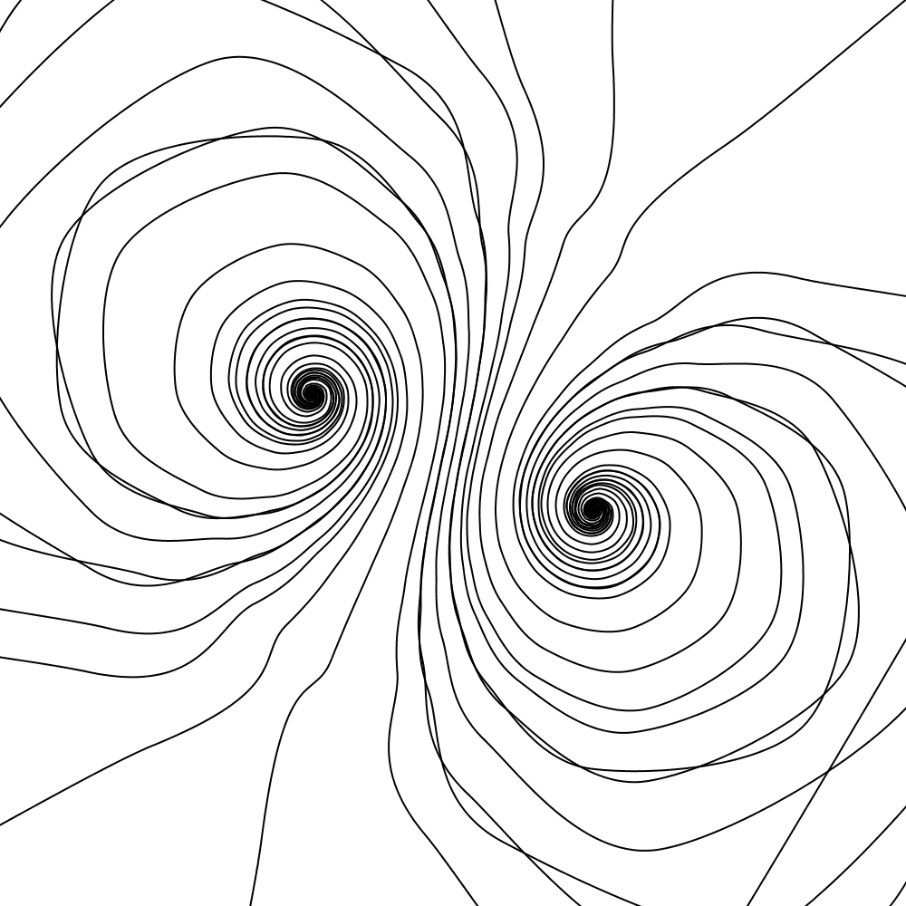
Möbius Maps
$$\left(\begin{matrix}1−5ⅈ & 1 \\ 1+ⅈ & 1−5ⅈ\end{matrix}\right)$$
$$\left(\begin{matrix}2/{\sqrt{3}} & 1 \\ −0.1ⅈ & 2/{\sqrt{3}}\end{matrix}\right)$$

Slide 8
Möbius Maps
Important Properties:
Circles are invariant under Möbius maps
(Circles stay circles)
If we multiply every entry by a constant, it’s the same transformation.
$$k\left(\begin{matrix}a & b \\ c & d\end{matrix}\right)(z)=\frac{kaz+kb}{kcz+kd}=\frac{k\left(az+b\right)}{k\left(cz+d\right)}=\frac{az+b}{cz+d}$$

Slide 9
Kleinian Groups
Determinant of 2x2 matrix
$$D=\left(\begin{matrix}a & b \\ c & d\end{matrix}\right)=ad −bc$$
Matrices up to scale form a group:
$$PSL\left(2,ℂ\right)$$
We can normalize any matrix to have determinant 1 by dividing each entry by $\sqrt{D}$

Slide 10
Kleinian Groups
Kleinian Group = a discrete subgroup of $PSL\left(2,ℂ\right)$
We care about Möbius maps that “pair circles”
$$M\left(z\right)=\frac{rs}{\left(z−P\right)}+Q$$
M

Slide 11
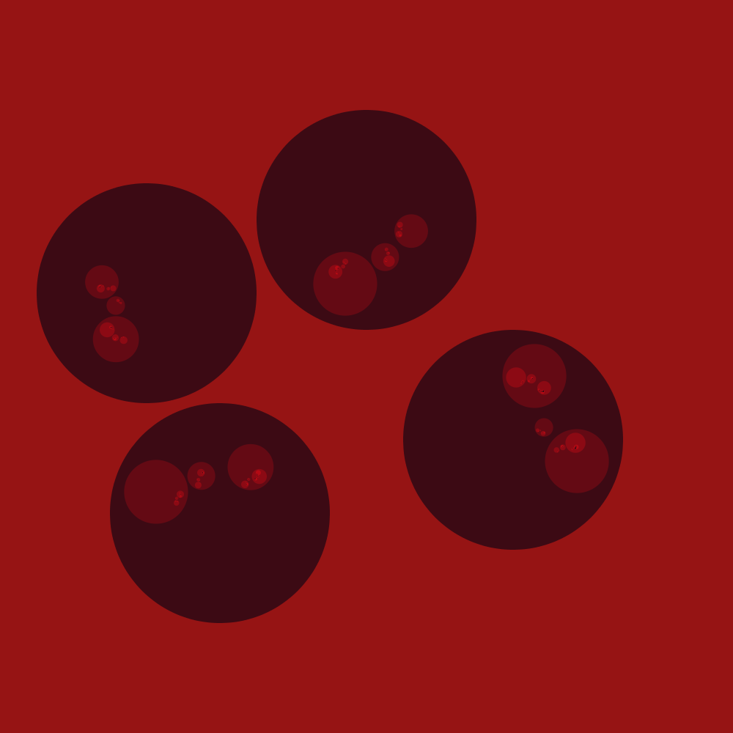
Schottky Circles
What happens when we combine circle pairing transformations?
$$a=\left(\begin{matrix}4/3 & 8/3+7/6ⅈ \\ −2/3ⅈ & 4/3−4/3ⅈ\end{matrix}\right)$$
$$b=\left(\begin{matrix}2/3+2i & & −\frac{10}{3}−{29}/6i & \\ −2/3ⅈ & & 2/3+4/3ⅈ & \end{matrix}\right)$$

Slide 12
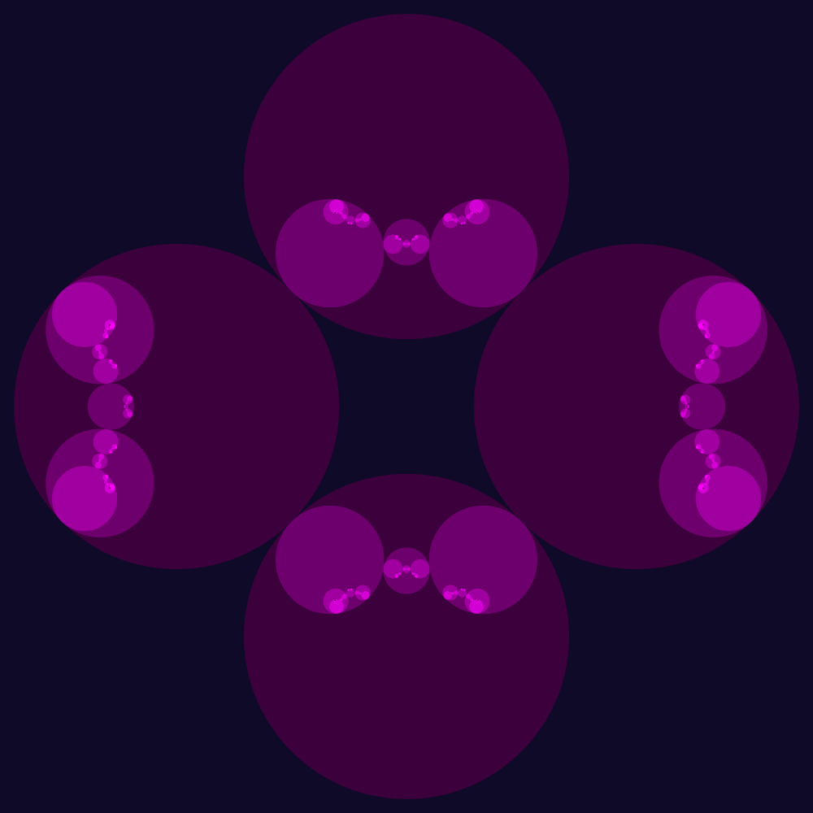
Schottky Circles
$$a=\left(\begin{matrix}−\sqrt{2} & ⅈ \\ −\dot{ⅈ} & −\sqrt{2}\end{matrix}\right)$$
$$b=\left(\begin{matrix}\sqrt{2}ⅈ & −3ⅈ \\ −ⅈ & \sqrt{2}\end{matrix}\right)$$
Now, let’s pair tangent circles

Slide 13
Schottky Circles
$$a=\left(\begin{matrix}\sqrt{2} & −1 \\ 1 & \sqrt{2}\end{matrix}\right)$$
$$b=\left(\begin{matrix}\sqrt{2} & 1 \\ 1 & \sqrt{2}\end{matrix}\right)$$
Let’s make all the image circles tangent too!

Slide 14
Limit Sets
Now, all we care about are the points we get after applying the transformations infinitely many times

Slide 15
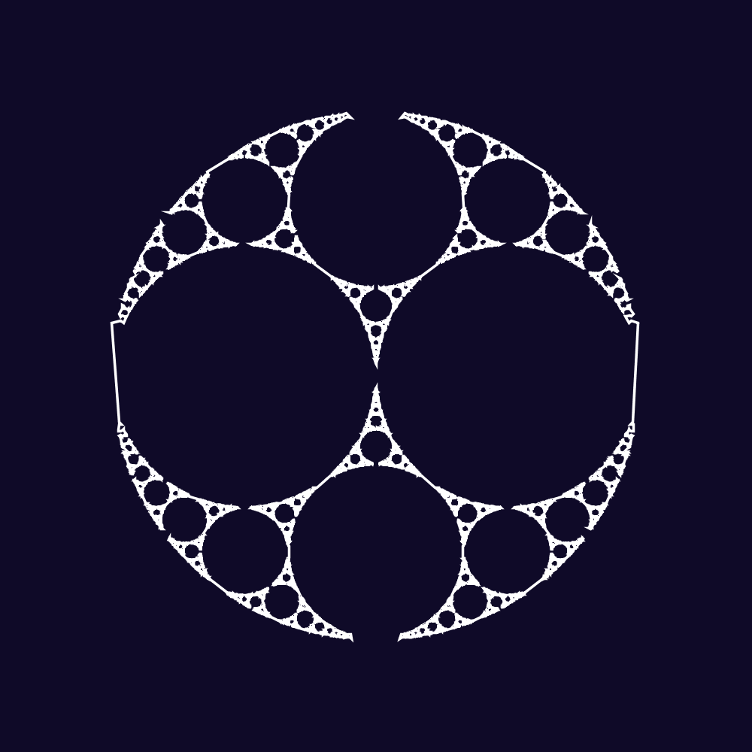
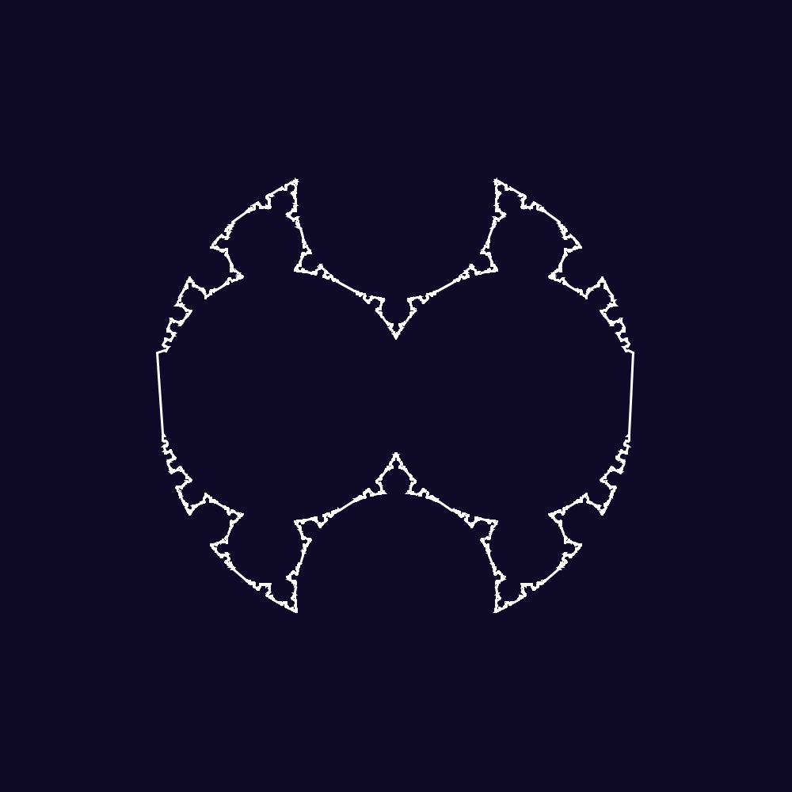
Limit Sets

Slide 18
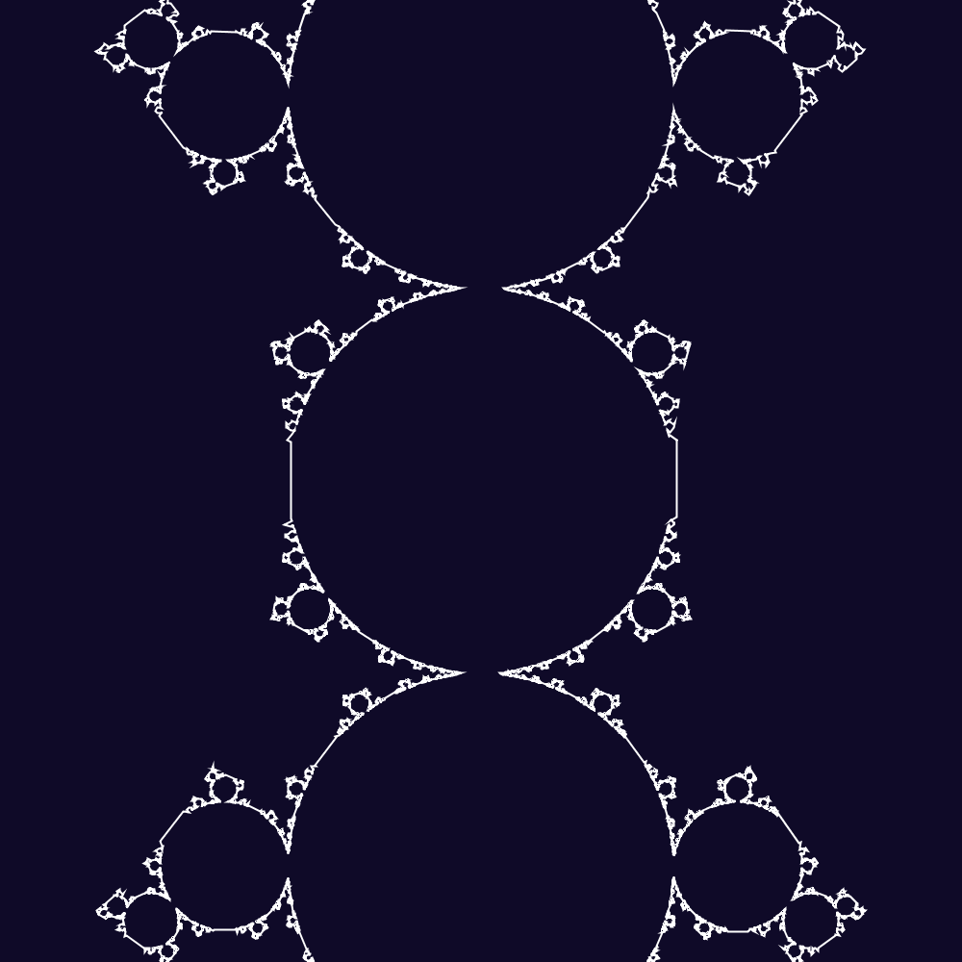

Slide 19
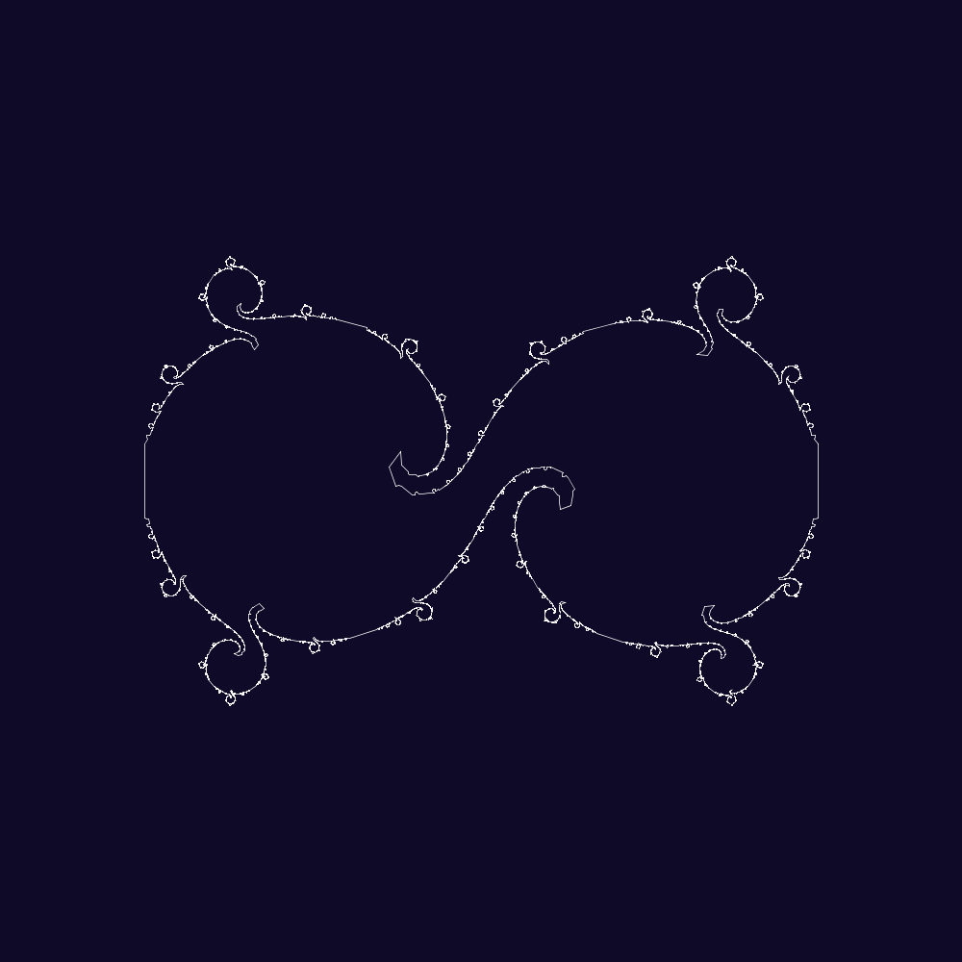

Slide 20
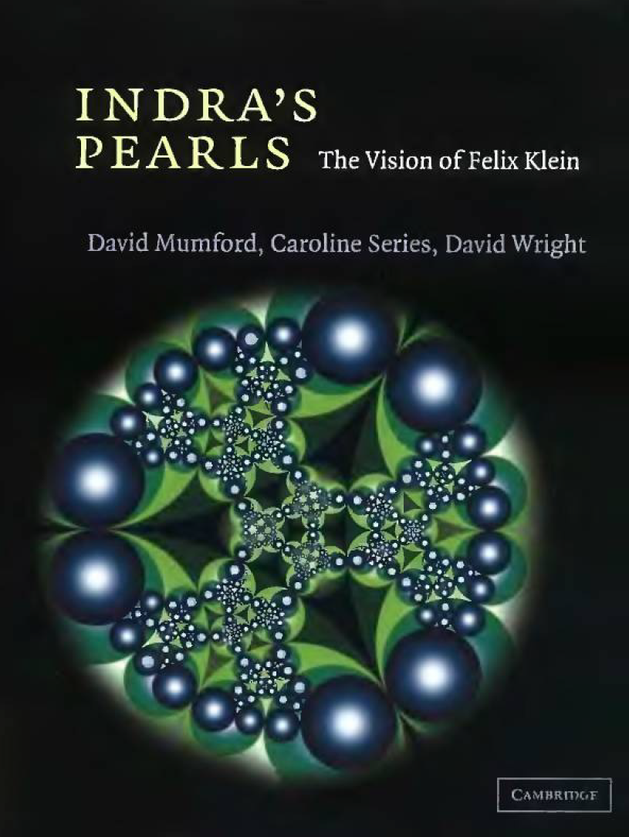
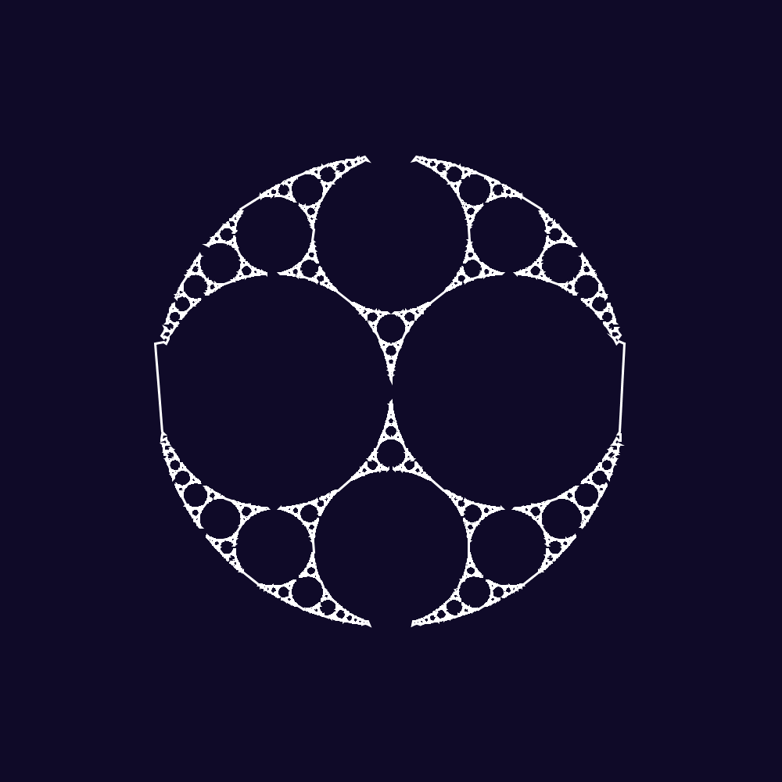
Thanks
Mentor: J-P Burelle
Textbook: Indra’s Pearls

