Slide 1
DRP
Carl Gauss
“Mathematics is the queen of sciences”
“Number Theory is the queen of mathematics”

Slide 2
Number Theory
Whole Numbers
Cryptography

Slide 3
Modular Arithmetic (General)
Generic Expression
Foundation Knowledge
A modulo B == C
A: ‘dividend’
Modulo = mod = %
B: ‘modulus’
==: Indicates congruency
C: remainder derived from A/B

Slide 4
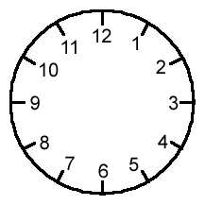
Clock Analogy

Slide 5
Computer Science Algorithm
Algorithm for Most Programming Languages:
Quotient = RoundToZero(A/B)
Remainder = A – (Quotient * B)

Slide 6
Pure Math
Modular Arithmetic
-1 mod 4 == …-5, -1, 3, 7…
Infinite possible answers, infinite remainders
Pure Math handles infinite sets

Slide 7
Applied Math
Java Modular arithmetic
Java Programming Language
Application limited to finite sets
Java picks number closest to zero as an ANSWER
-1 % 300 == -1 (8 bits)
-1 % 300 == 299 (10 bits)

Slide 8
Final Thoughts
Staff
Book
Chief DRP Mentor:
Tim Mercure
DRP Student:
Geri Dunellari
Auxiliary Resources:
Dr. Larry Washington
Corry Bedwell

