Slide 1
Data Mining and Machine Learning
Addison Euhus and Dan Weinberg

Slide 2
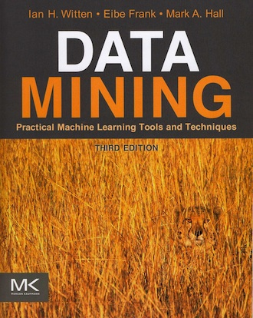
Introduction
Data Mining: Practical Machine Learning Tools and Techniques (Witten, Frank, Hall)
What is Data Mining/Machine Learning? “Relationship Finder”
Sorts through data… computer based
for speed and efficiency
Weka Freeware
Applications

Slide 3
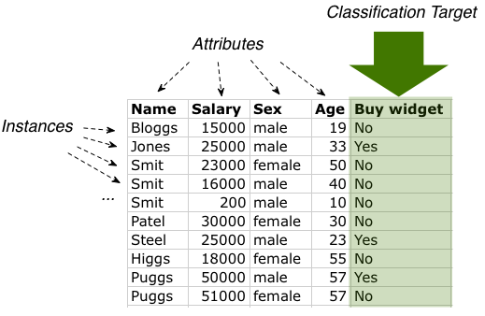
Components of Machine Learning
Concept/Relation: What is being learned from the data set
Instances: “Input”
Attributes: “Values”
Nominal, Ordinal, Interval, Ratio
“Name, Order, Distance, Number”

Slide 4
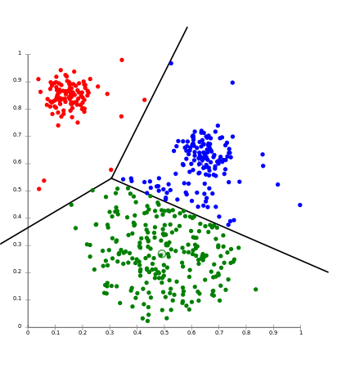
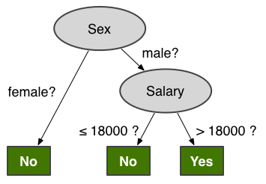
The Output
Variety of forms depending on the concept to be learned
Can be a table, regression, chart/diagram, grouping/clustering, decision tree, or set of rules
Different output will describe different things about same set of data
Cross Validation

Slide 5
Some Algorithms in Machine Learning
Decision Trees (ID3 Method)
Split an attribute into tree nodes and categorize the data and continue splitting into further nodes
Want to chose the attribute that is most “pure” – quantitatively speaking, most amount of “information”
Entropy(x,y,z) = -xlog₂(x)-ylog₂(y)-zlog₂(z), the amount of uncertainty in the data set
info([a,b,c]) = entropy(a/t,b/t,c/t) where t=a+b+c

Slide 6
Decision Trees Continued
Gain(Attribute) = info(unsplit) – info(split)
The attribute with the most gain should be split first in the decision tree algorithm
An example:
Gain = info([9,5])-info([2,3],[4,0],[3,2]) = .247
Attribute
Yes
Yes
Yes
No
No
Yes
Yes
No
No
No
Yes, Yes, Yes, Yes

Slide 7
Other Algorithms
Covering Approach:
Creates a set of rules, unlike a decision tree
However, Same top-down, divide and conquer approach
Begin with the end values and then choose the attribute with the most “positive instances”
For ratio attributes, models such as line-of-best-fit and other regressions are used
Least-Squares regression

Slide 8
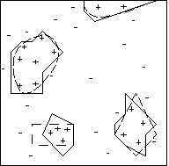
Instance-Based Learning
At run-time the program uses a variety of different calculations to find instances that are most similar to the test instance
Find the “nearest-neighbor,” based off of “distances”
Measures “distances” and how close one instance is to another. The closest instances have their value assigned to the test instance
Standard Euclidean or alternative forms

Slide 9
Applications
Wine Quality Dataset
Nearest Neighbor: 65.39% Accuracy
Decision Tree: 58.25% Accuracy

Slide 10
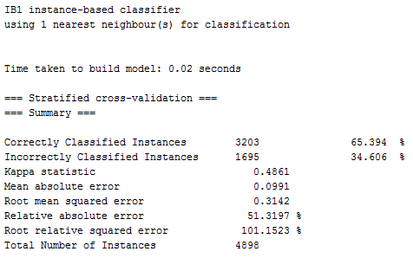
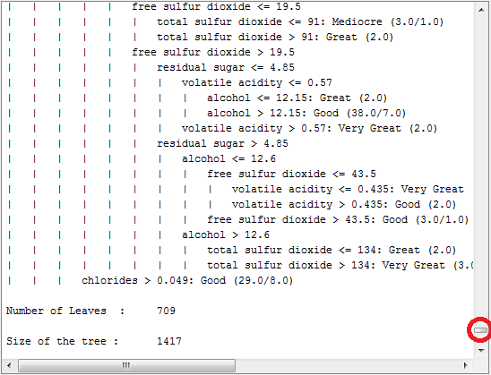
Wine Quality Output
Decision Tree
Nearest Neighbor

Slide 11
A Challenging Classification Problem
Shortfalls and Limitations
Poker Hands: (Used with over 5,000 different instances)
Decision Tree: 55.90%
Nearest Neighbor: 46.86%
Some speed algorithms: <35%
The issue: Suit is numerical (0,1,2,3) as well as the order the cards are presented in

