Slide 1
Options Pricing and Black-Scholes
By Addison Euhus, Guidance by Zsolt Pajor-Gyulai

Slide 2
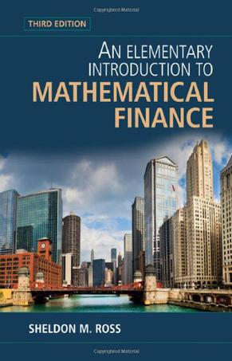
Summary
Text: An Elementary Introduction to Mathematical Finance by Sheldon M. Ross
RV and E(X)
Brownian Motion and Assumptions
Interest Rate r, Present Value
Options and Arbitrage, Theorem
Black-Scholes, Properties
Example

Slide 3
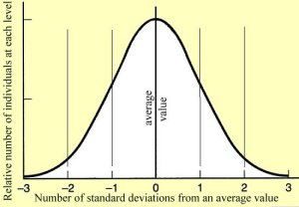
Random Variables, E(X)
Interesting random variables include the normal random variable
Bell-shaped curve with mean μ and standard deviation σ
Continuous random variable
Φ(x) = P{X < x}
CLT: Large n, sample will
be approximately normal

Slide 4
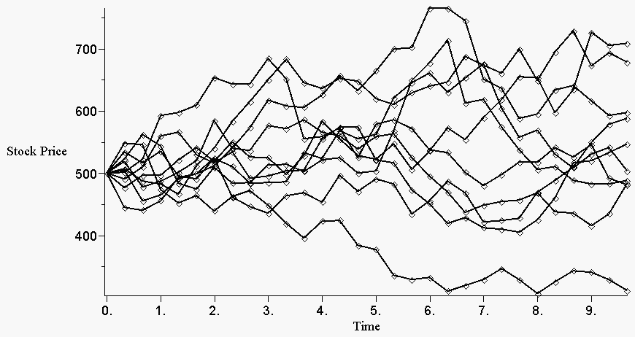
Lognormal and Brownian Motion
A rv Y is lognormal if log(Y) is a normal random variable
Y = e^{X}, E(Y) = e^{μ+ σ2/2}
Brownian Motion: Limit of small interval model, X(t+y) – X(y) ~ N(μt, tσ²)
Geometric BM: S(t) = e^{X(t)}
log[(S(t+y)/S(y)] ~ N(μt, tσ²), indp. up to y
Useful for pricing securities – cannot be negative, percent change rather than absolute

Slide 5
Interest Rate & Present Value
Time value of money: P + rP = (1+r)P
Continuous compounding
r_{eff} = (actual – initial) / initial
Present Value: v(1+r)^{-i}
Cash Flow Proposition and Weaker Condition
Rate of return makes present value of return equal to initial payment
r = (return / initial) – 1
Double payments example

Slide 6
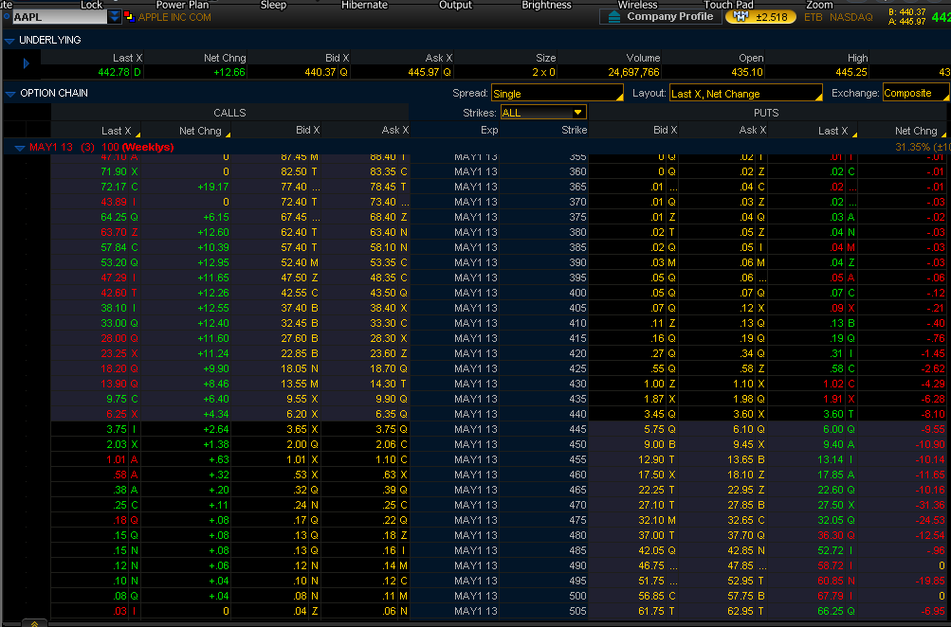
Options & Arbitrage
An option is a literal “option” to buy a stock at a certain strike price, ‘K’, in the future
A put is the exact opposite
Arbitrage is a sure-win betting scheme
Law of One Price: If two investments have same present value, then C₁=C₂ or there is arbitrage
Arbitrage Example
The Arbitrage Theorem: Either p such that Sum[p*r(j)] = 0 or else there is a betting strategy for which Sum[x*r(j)] > 0
p = (1 + r – d) / (u – d)

Slide 7
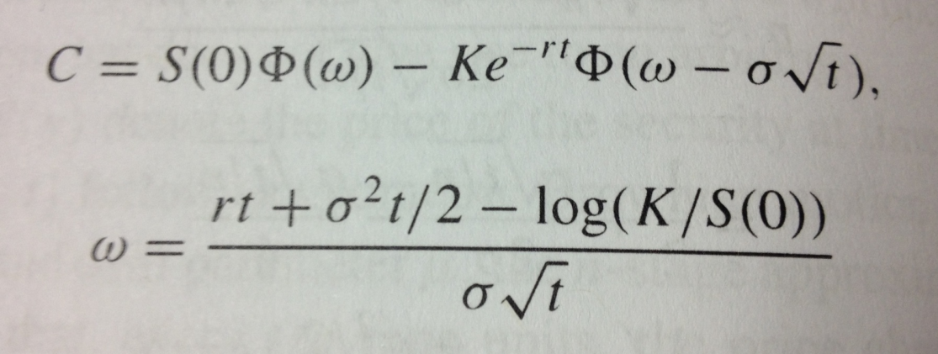
Black-Scholes, Properties
C is no-arbitrage option price
C(s, t, K, σ, r)
Phi is normal distribution
Under lognormal, Brownian motion assumptions
Fischer Black, Myron Scholes in 1973
s↑, K↓, t↑, σ↑, r↑
∂/∂s(C) = Φ(w)

Slide 8
Black-Scholes Example
A security is presently selling for $30, the current interest rate is 8% annually, and the security’s volatility is measured at .20. What is the no-arbitrage cost of a call option that expires in three months with strike price of $34?
w = [.02 + .005 – ln(34/30)]/.10 ~ -1.0016
C = 30Φ(w) – 34e-.02Φ(w-.10) = .2383 = 24¢

