Slide 1
An Introduction To Uncertainty Quantification
By Addison Euhus, Guidance by Edward Phillips

Slide 2
Book and References
Book – Uncertainty Quantification: Theory, Implementation, and Applications, by Smith
Example Source/Data from http://helios.fmi.fi/~lainema/mcmc/

Slide 3
What is Uncertainty Quantification?
UQ is a way of determining likely outcomes when specific factors are unknown
Parameter, Structural, Experimental Uncertainty
Algae Example: Even if we knew the exact concentration of microorganisms in a pond and water/temperature, there are small details (e.g. rock positioning, irregular shape) that cause uncertainty

Slide 4
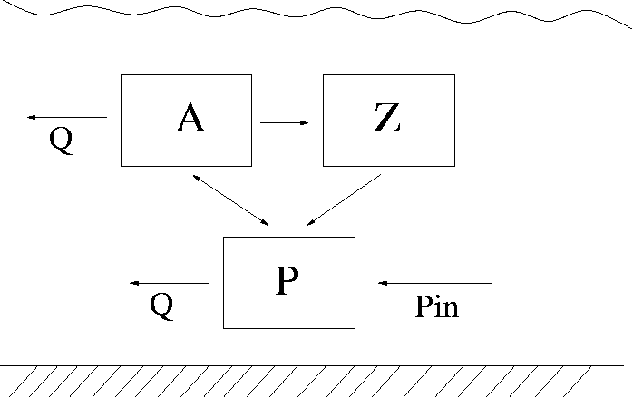
The Algae Example
Consider the pond with phytoplankton (algae) A, zooplankton Z, and nutrient phosphorous P

Slide 5
The Algae Example
This can be modeled by a simple predator prey model

Slide 6
Observations and Parameters
Concentrations of A, Z, and P can be measured as well as the outflow Q, temperature T, and inflow of phosphorous P_{in}
However, the rest of the values cannot be measured as easily – growth rate mu, rho’s, alpha, k, and theta. Because of uncertainty, these will be hard to determine using standard methods

Slide 7
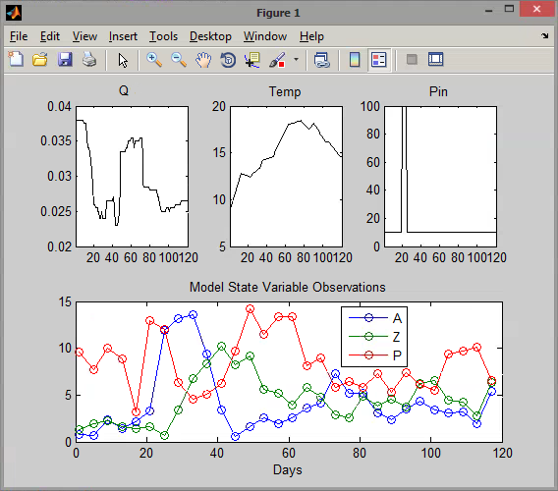
Observed Algae Data

Slide 8
Statistical Approach: MCMC
Markov Chain Monte Carlo (MCMC) Technique
“Specify parameter values that explore the geometry of the distribution”
Constructs Markov Chains whose stationary distribution is the posterior density
Evaluate realizations of the chain, which samples the posterior and obtains a density for parameters based on observed values

Slide 9
DRAM Algorithm
Delayed Rejection Adaptive Metropolis (DRAM)
Based upon multiple iterations and variance/covariance calculations
Updates the parameter value if it satisfies specific probabilistic conditions, and continues to iterate on the initial chain
“Monte Carlo” on the Markov Chains

Slide 10
Running the Algorithm
Using MATLAB code, the Monte Carlo method runs on the constructed Markov Chains (the covariance matrix V)
After a certain amount of iterations, the chain plots will show whether or not the chain has converged to values for the parameters
After enough iterations have been run, the chain can be observed and the parameter calculations can be used to predict behavior in the model

Slide 11
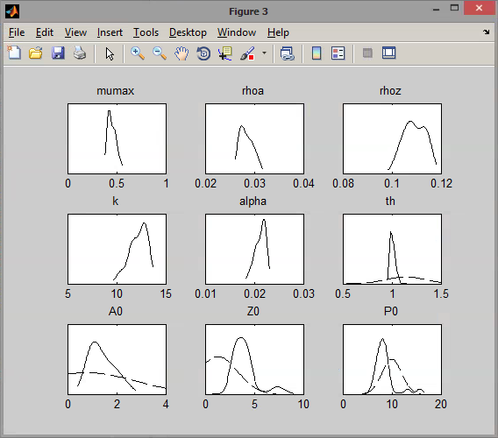
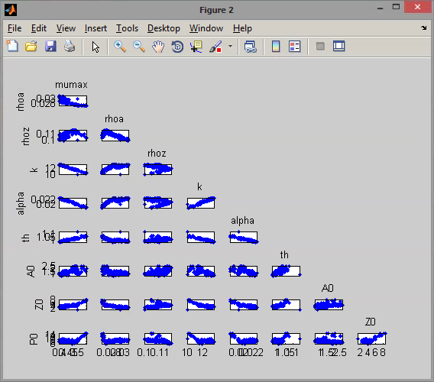
Small Iterations

Slide 12
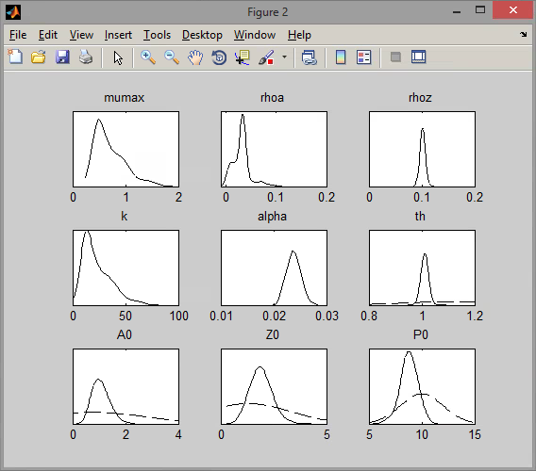
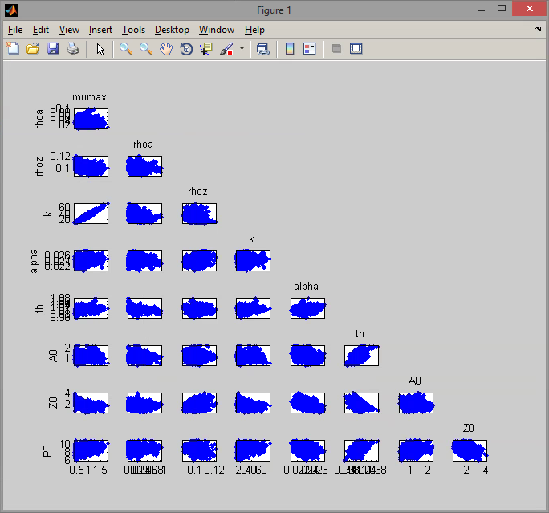
Large Iterations

Slide 13
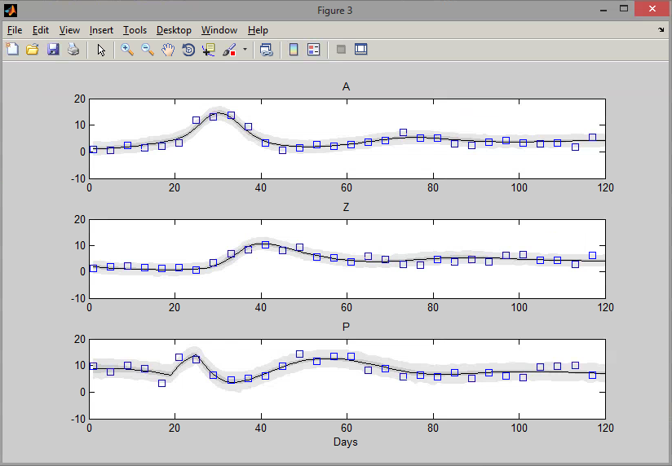
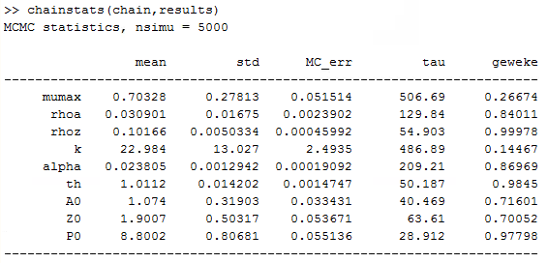
Results from the Algae Model

