Slide 1
Intro to the Brownian Motion
Yufan Fei
“Introduction to Stochastic Calculus with Applications”. By Fima C Klebaner

Slide 2
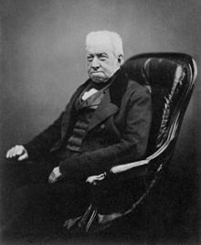
What is a so-called Brownian Motion?
Robert Brown
This phenomenon was found by a Scottish botanist Robert Brown while examining grains of pollen of the plant in water under a microscope in 1827.
(21 December 1773 – 10 June 1858)
http://www.npg.org.uk/collections/search/portraitLarge/mw00850/Robert-Brown?
Notes:
Behavior of the movement is different from what he expected to see. Constantly direction changing. Non-smooth. Mathematical movement with random path

Slide 3
Mathematical properties
Brownian Motion is a stochastic process:
Independence of increments
B(t) - B(s), for t > s, is independent of the past.
Normal increments
B(t) - B(s) has normal distribution with mean 0 and variance t-s. → B(t)- B(s) ~ N (0, t-s) distribution
Continuity of paths
B(t), t >= 0 are continuous functions of t.
Notes:
What it is? Explain the math as a random variable.

Slide 4
Independence of Increments
Recall experiments done by Robert Brown
Particles of pollen grains moved through the water resulting from individual molecules
The direction of the force of atomic bombardment is constantly changing
Direction of the combined force is unpredictable
Force always exists

Slide 5
Normal Increments
Movement due to instantaneous imbalance in the combined forces
Since a water molecule is 10^5 times smaller than a pollen particle, the pollen appears to travel with irregular movements.
By the central limit theorem, the arithmetic mean of a sufficiently large number of iterates of independent random variables will be approximately normal distributed.

Slide 6
Continuity of Paths
This property makes an intuitive sense
The only way to have a discontinuous path is that a particle suddenly blinks to another location
But a particle is not able to jump out of the universe

Slide 7
Graphical meaning
Graphically speaking, a Brownian Motion is a “function” that has equivalent probability of increasing and decreasing in an incremental time interval.
Every increment over an interval of length (t-s) is normally distributed with mean 0 and variance (t-s).

Slide 8
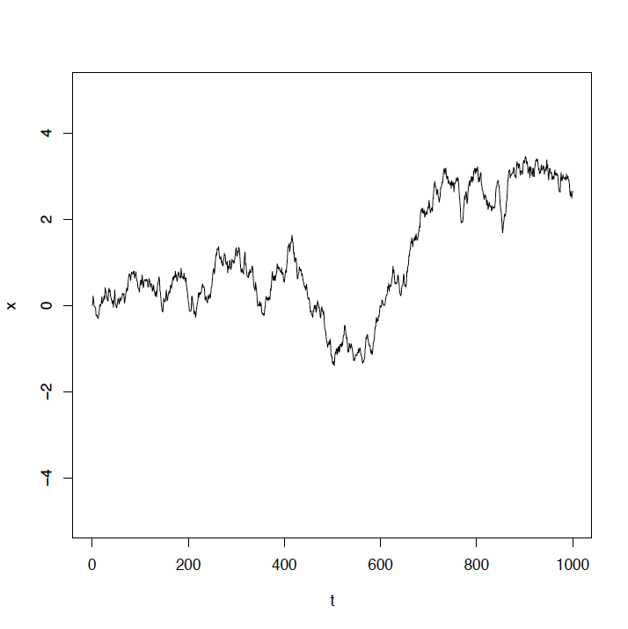
One path of B(t)

Slide 9
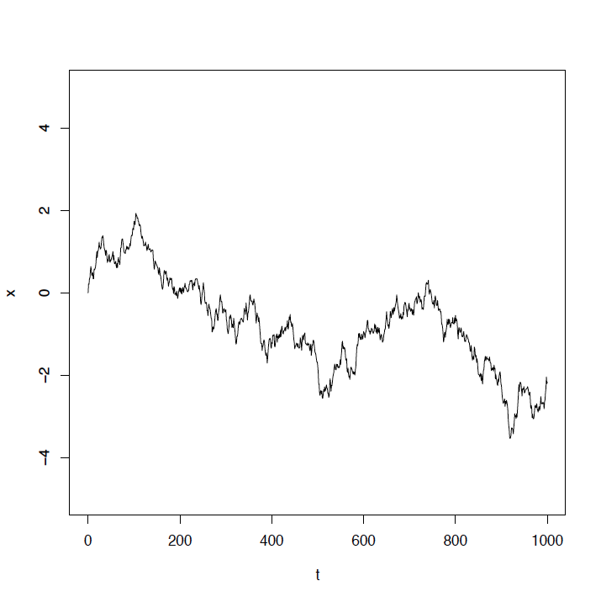
One path of B(t)

Slide 10
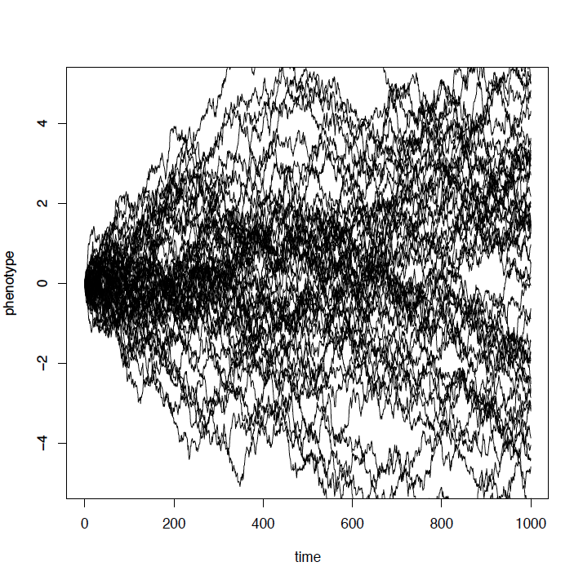
Fifty simulations of B(t)
Notes:
Symetric distribution, equal likely to go up or down.

Slide 11
Unique feature of path
Almost every sample path B(t)
Is not monotone at any interval
Pick any interval [a, b], there exists infinite many small intervals such that P(B(t) is monotone on [a, b]) = 0
Is not differentiable at any time
Consider , then the limit does not converge because B(t) is neither decreasing nor increasing. Thus there exists a sequence {t_{n}} converging to t such that B(t_{n})-B(t) is positive for some n and negative for other n.

Slide 12
Markov property
A Brownian Motion does not remember how it goes to the present state.
Markov property
Probability distribution based on information from the past (Given path)
= Probability distribution given its current state
(B(t) | B(1) = 1) has the same distribution as 1 + W(t),
Where W(t) is a different Brownian Motion
Notes:
Do plot when talking about W(t)

Slide 13
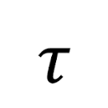
Application in real-life
If we define the exit time for a Brownian Motion as the minimum time it would take to exit an interval
The exit time for a Brownian Motion is always less than infinity.
By using Markov property and reflection principle, we can establish the distribution of the maximum (minimum) of B(t) on [0, t]
Notes:
Consider xxx

Slide 14
Work Cited
Zhang, Lixin. "Functions of Brownian Motion." (n.d.): n. pag. Http://www.math.zju.edu.cn/zlx/forphd/ch1-5and6.pdf. Web.
Fima C Klebaner. “Introduction to Stochastic Calculus with Applications”. Third Edition. Imperial College Press

