Slide 1
Non-Linear Dimensionality Reduction
Presented by: Johnathan Franck
Mentor: Alex Cloninger

Slide 2
Outline
Different Representations
5 Techniques
Principal component analysis (PCA)/Multi-dimensional scaling (MDS)
Sammons non-linear mapping
Isomap
Kernel PCA
Locally linear embedding
Notes:
Less details

Slide 3
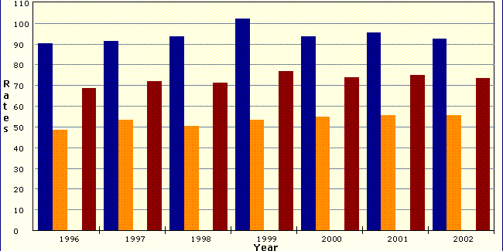
Different viewpoints
Notes:
Pull out specific information using mathematical techniques

Slide 4
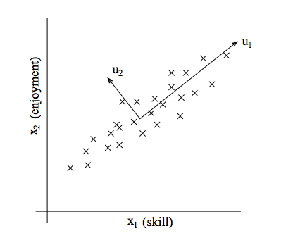
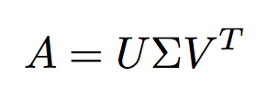
Principal Component Analysis/Multidimensional Scaling
Singular Value Decomposition of A:

Slide 5
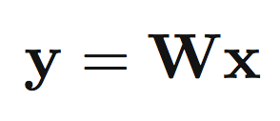
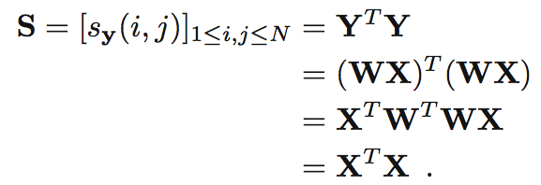
PCA/MDS Formulation
X – reduced dimension Y – higher dimension
W - Orthogonal
Singular Value decomposition of Y equivalent to
Eigenvalue decomposition of gram matrix
Preserve Gram Matrix: S
Optimization:
Linear Algebra
Distance Preserved Rotation

Slide 6
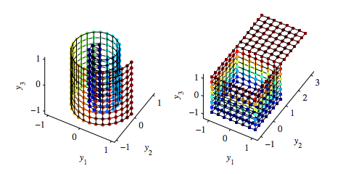
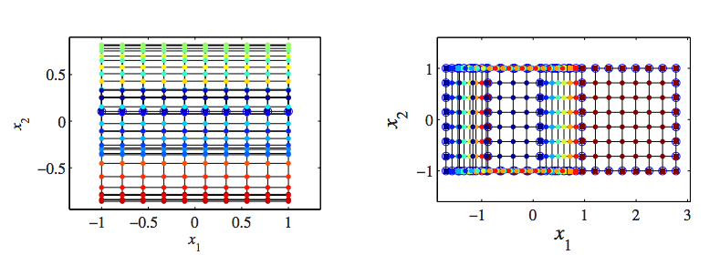
Swiss Roll
Open Box

Slide 7
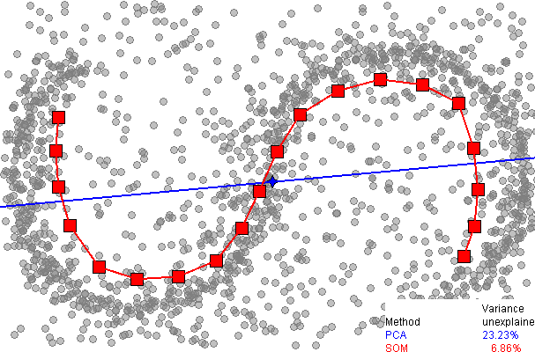
Sammons Nonlinear mapping
Weight distances differently

Slide 8
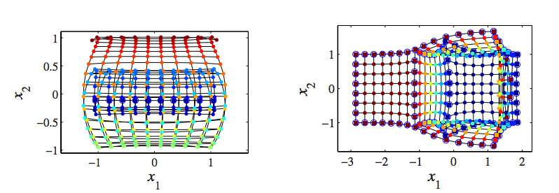
Swiss Roll
Open Box

Slide 9
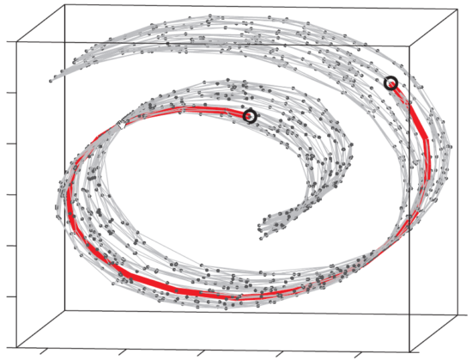
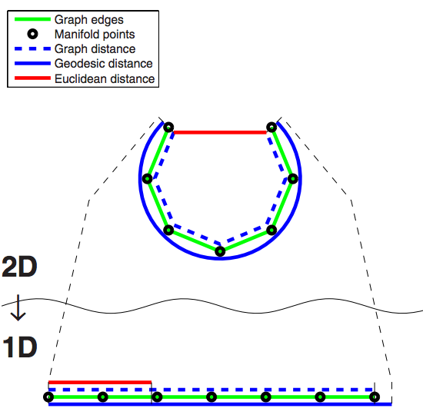
Isomap
Approximate geodesic
Build graph with
K-neighbors/ε-ball
Weight graph with Euclidean distance
Compute pairwise distances with Dijkstra’s algorithm

Slide 10
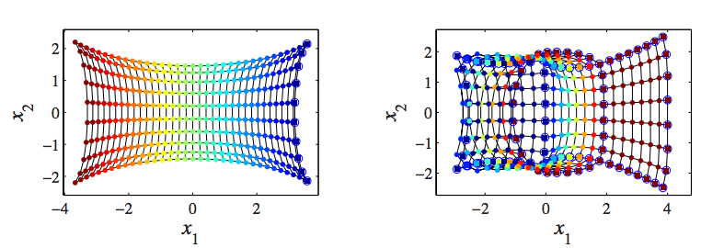
Swiss Roll
Open Box

Slide 11
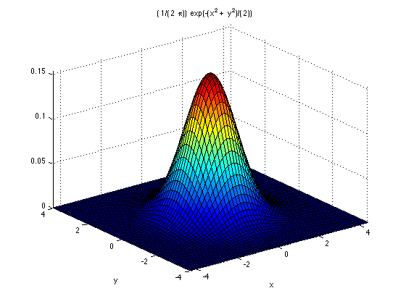
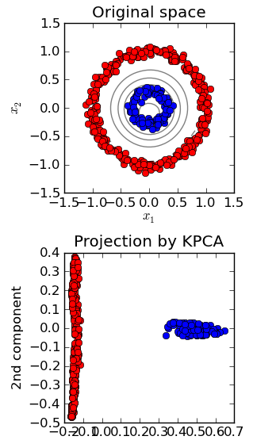
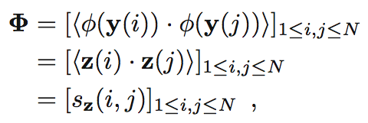
Kernel PCA
What other distance functions?
Mercer’s theorem

Slide 12
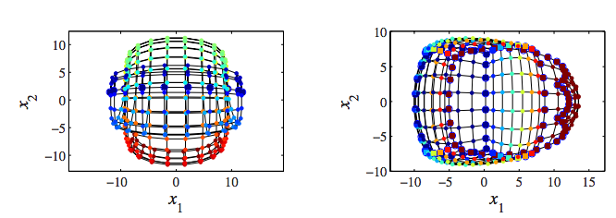
Swiss Roll
Open Box

Slide 13
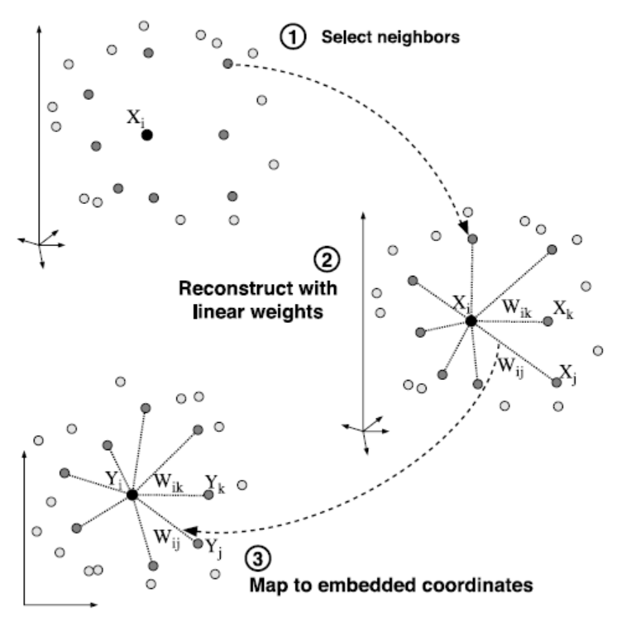
Local Linear Embedding
Preserve relation to local points

Slide 14
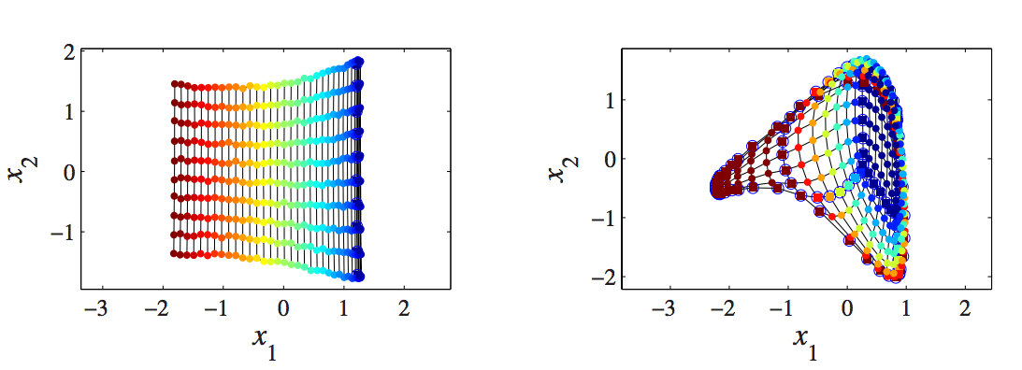
Swiss Roll
Open Box

Slide 15
Isomap
Original 3 dimensions
PCA
Kernel PCA
Sammon’s nonlinear mapping
Locally Linear Embedding

Slide 16
Thanks
Mentor: Alex Cloninger
DRP program
Contact information:
Jafranck2@gmail.com

Slide 17
Sources
Images
Nonlinear Dimensionality reduction
By John Lee and Michael Verleyson
http://blog.pluskid.org/wp-content/uploads/2010/05/isomap-graph.png
http://imagineatness.files.wordpress.com/2011/12/gaussian.png
http://scikit-learn.org/0.11/_images/plot_kernel_pca_1.png
http://www.cs.nyu.edu/~roweis/lle/images/llef2med.gif
http://upload.wikimedia.org/wikipedia/commons/b/bb/SOMsPCA.PNG

