Slide 1
Solving a Maze using Graph Algorithms
By Clara Bryant

Slide 2
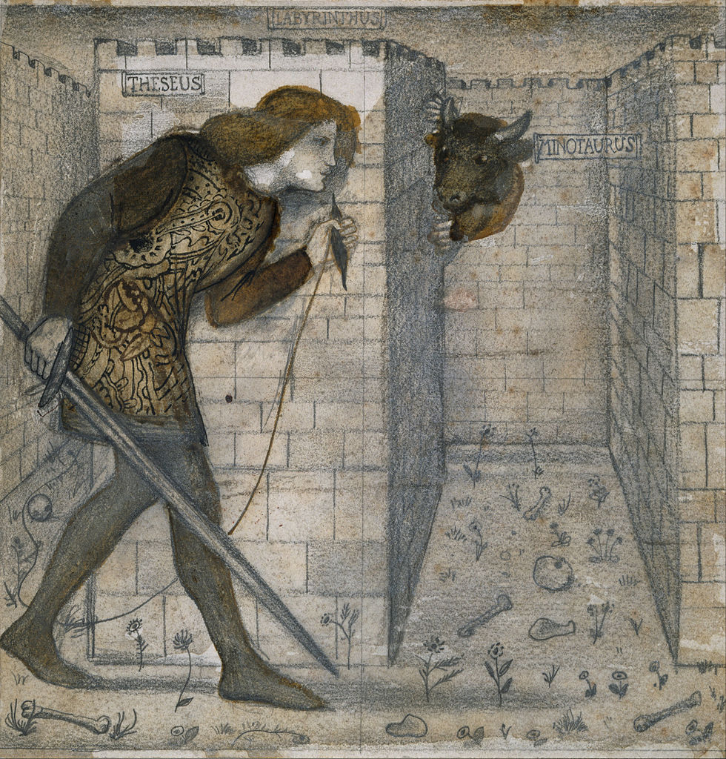
How a Human solves a Maze
Greek Myth of the Minotaur
Greek hero Theseus is given string to find his way through and back out of the maze
String and chalk method to solve a maze
Mark the places you’ve visited already

Slide 3
What is a graph?
A graph is a representation of connections between points
Similar to graph representations of molecules
The representation does not look like how the molecule looks in reality, but helps you understand the collections between the atoms
“nodes” = circles; points of connection
“vertices” = lines; connections themselves
The Graph Representation
of a Water Molecule

Slide 4
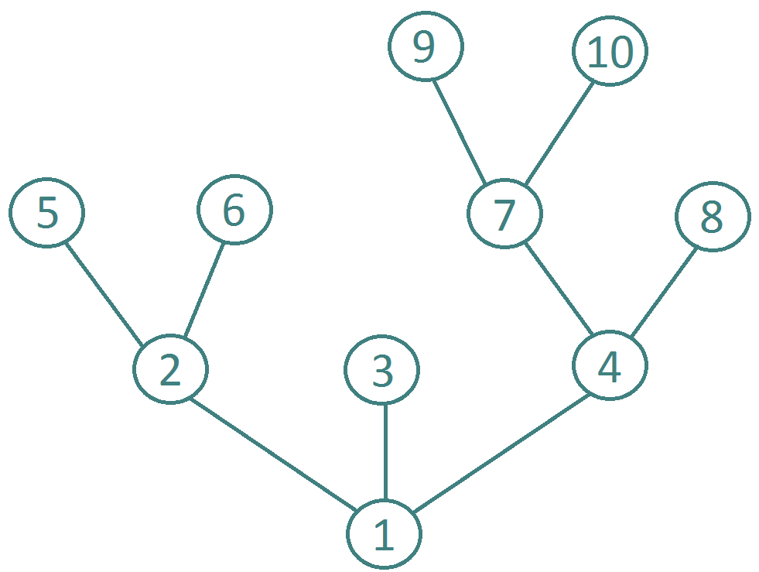
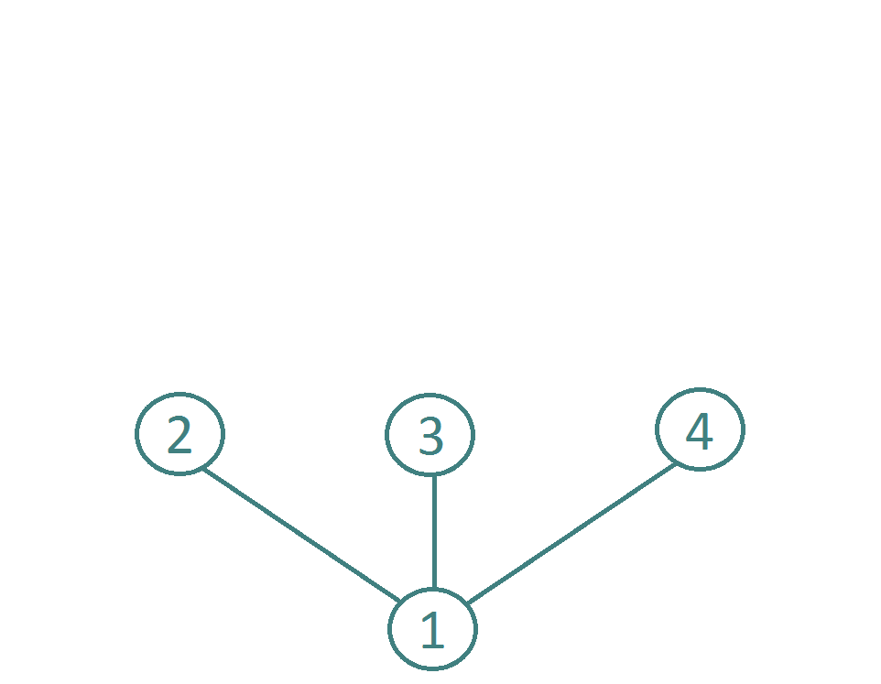
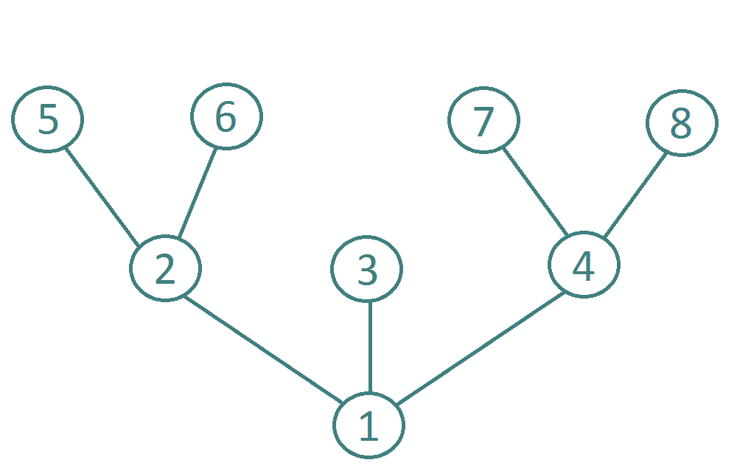
Converting a maze to a graph

Slide 5
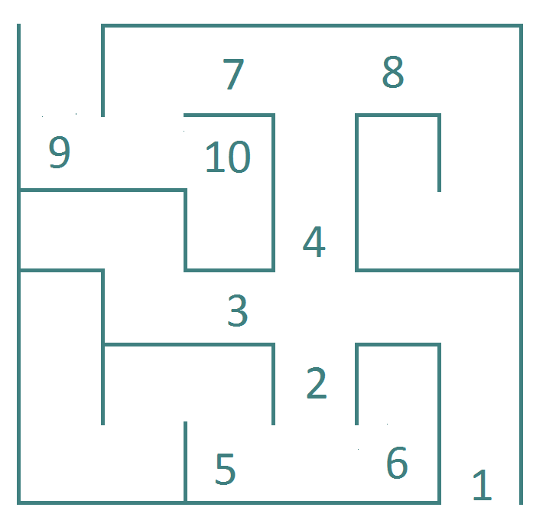
Algorithm* for Converting a maze to a graph
For every time you have a choice in path, you number that choice
These are the nodes
Starting from the entrance, draw one connection (one vertex) for every “hallway”
Draw one node for every choice in path
Make a new level of connections for every group of choices you encounter
The graph will be in the shape of a tree:
https://www.youtube.com/watch?v=k1tSK5V1pds
*Algorithm = series of steps to follow

Slide 6
Depth-first search
A graph algorithm
Solves tree graphs branch-by-branch
Similar to the string-and-chalk method, but follows the order of the nodes instead of making “random” choices
What it looks like: https://www.cs.usfca.edu/~galles/visualization/DFS.html

Slide 7
The Solution

Slide 8
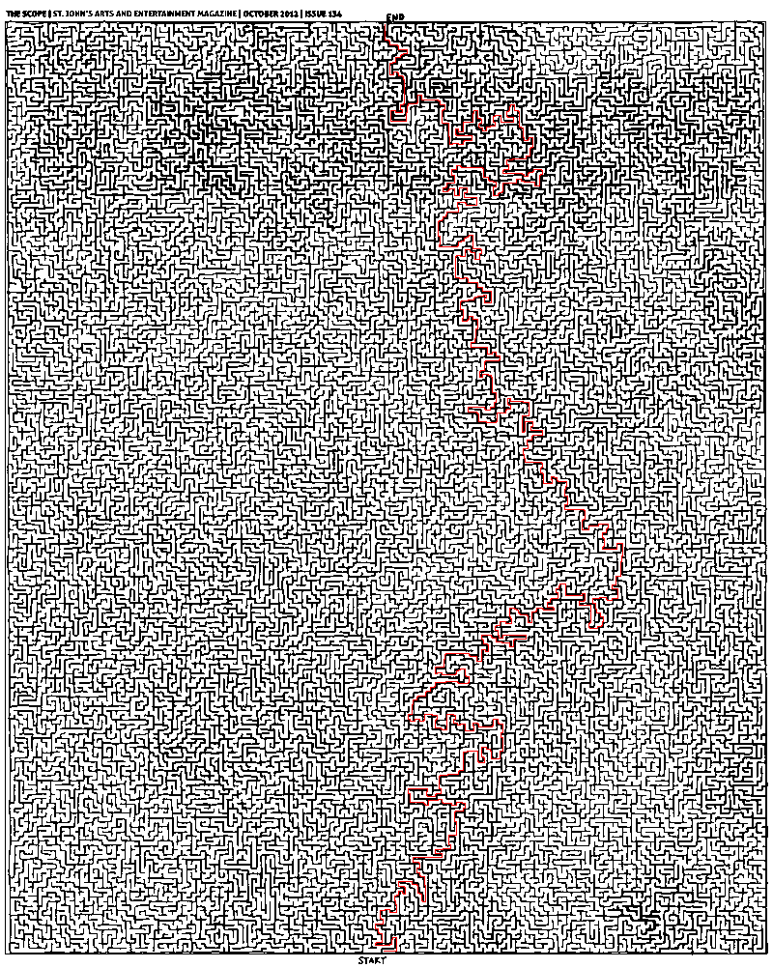
More Complicated Example
Some mazes take a really long time for a human to solve on their own
We can use computers and coding to implement graph search algorithms
http://stackoverflow.com/questions/12995434/representing-and-solving-a-maze-given-an-image?rq=1

Slide 9
Breadth-First search
Solves tree graphs level-by-level
Could be implemented in real life if you can multiple people in the maze
What they look like: https://www.cs.usfca.edu/~galles/visualization/BFS.html

Slide 10
Thank You.

