Slide 1
Using Classification Trees to Decide News Popularity
Xinyue Liu

Slide 2
The News Popularity Data Set
Goal: compare the performance of the two algorithms on the same dataset.
Source and Origin
Goal
Instances and Attributes
Examples

Slide 3
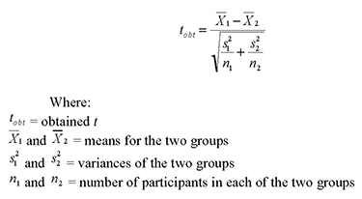
Data Description Significant Variables Selection

Slide 4
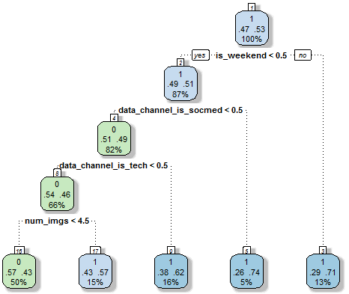
Decision Tree
Iteratively split variables into groups
Evaluate “homogeneity” within each group
Split again if necessary
Weekdays
Weekends

Slide 5
Decision Tree
Pros:
- Easy to Interpret
- Better performance in nonlinear settings
Cons:
- Without pruning can lead to overfitting
- Uncertainty

Slide 6
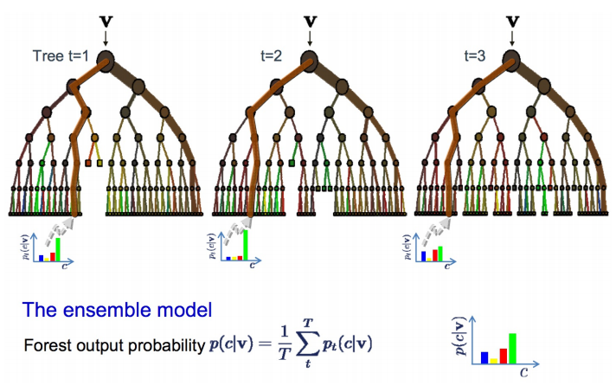
Random Forest
Bootstrap: random sampling with replacement
Bootstrap samples and variables
Grow multiple trees and average

Slide 7
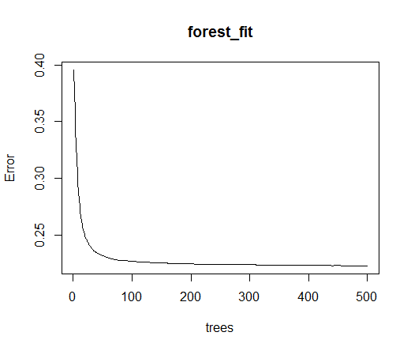
Random Forest
Pros:
Pros:
- Accuracy
Cons:
- Speed
- Hard to interpret
- Overfitting

Slide 8
Solution
Decision Tree
Random Forest
Accuracy: 0.5056
Sensitivity : 0.4552
Specificity : 0.5273
Accuracy: 0.5068
Sensitivity : 0.4628
Specificity : 0.5339

Slide 9
Conclusion
Both algorithms do not perform well on this dataset.
The day the news published, the topic, and the number of images decide the popularity of the online news.
Resort to other machine learning algorithms.
Weekdays
Weekends

Slide 10
References
Trevor Hastie, Rob Tibshirani. “Statistical Learning.” Statistical Learning. Stanford University Online CourseWare, 21 August 2015. Lecture. http://online.stanford.edu/course/statistical-learning-winter-2014
Andrew Liu. “Practical Machine Learning.” Practical Machine Learning. Coursera, 21 August 2015. Lecture.

Slide 11
Thank you!

