Slide 1
Number Theory:
Farey Sequences
Kaela MacNeil
Mentor: Sean Ballentine

Slide 2
Definition
The nth Farey sequence is the sequence of fractions between 0 and 1 which has denominators less than or equal to n in reduced form
  These fractions are arranged in increasing size from 0/1, the first fraction, to 1/1, the last fraction

Slide 3
Farey Sequences of Orders 1-7
F₁ = {0/1, 1/1}
F₂ = {0/1, 1/2, 1/1}
F₃ = {0/1, 1/3, 1/2, 2/3, 1/1}
F₄ = {0/1, 1/4, 1/3, 1/2, 2/3, 3/4, 1/1}
F₅ = {0/1, 1/5, 1/4, 1/3, 2/5, 1/2, 3/5, 2/3, 3/4, 4/5, 1/1}
F₆ = {0/1, 1/6, 1/5, 1/4, 1/3, 2/5, 1/2, 3/5, 2/3, 3/4, 4/5, 5/6, 1/1}
F₇ = {0/1, 1/7, 1/6, 1/5, 1/4, 2/7, 1/3, 2/5, 3/7, 1/2, 4/7, 3/5, 2/3, 5/7, 3/4, 4/5, 5/6, 6/7, 1/1}
Notice how the increases in length of order varies!

Slide 4
Farey Sequence Length
Notice that F_{n} contains all the members of F_{n-1}
The fractions added to the nth sequence are all of the form k/n where k < n
But if k and n are not coprime, then the fraction was accounted for in a previous sequence and therefore not added

Slide 5
Formula for Sequence Length
Since we add a fraction for each positive integer coprime and less than n, we end up increasing the sequence length by φ(n), the Euler totient function, when going from F_{n-1} to F_{n}
This gives us |F_{n}| = |F_{n-1}| + φ(n)
Using the fact that |F₁| = 2, we get:

Slide 6
Farey Neighbors
Fractions which appear as neighbors in some Farey sequence have interesting properties
  These neighbors are known as a Farey pair
If a/b and c/d are a Farey pair, and a/b < c/d, then bc – ad = 1
Shockingly, the converse is also true: if bc – ad = 1, then a/b and c/d are a Farey pair for some n
They are a Farey pair in F_{n} where n = max(b,d)

Slide 7
Example
5/7 and 3/4 satisfy bc – ad = 1
  So, 5/7 and 3/4 are a Farey pair in F_{n} where n is equal to max(7,4) which is equal to 7
F₇ = {0/1, 1/7, 1/6, 1/5, 1/4, 2/7, 1/3, 2/5, 3/7, 1/2, 4/7, 3/5, 2/3, 5/7, 3/4, 4/5, 5/6, 6/7, 1/1}

Slide 8
Splitting a Farey Pair
If we take any Farey pair, you may want to ask the question: What is the next fraction that will split this Farey pair?
It turns out, using the bc – ad = 1 formula, you can find out that the first fraction to split a Farey pair a/b and c/d will be its mediant a+c/b+d
It splits in F_{n} where n is equal to b+d

Slide 9
The First Geometric Construction
You can geometrically construct Farey numbers using the following process:
  Start with a unit square in the plane with the bottom-left corner at the origin
  Put (0,1) and (1,1) into a set we will call S
  At each stage, connect each point in S to the points below its left and right closest neighbor in x-value
  Then, add any intersection points to S

Slide 10
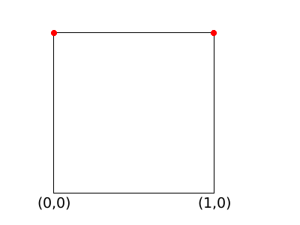
Example
Construct the set S starting with (0,1), (1,1)
At step 1, S contains two points:
    S = { (0,1), (1,1) }
The x-coordinates are the elements in F₁ : 0/1, 1/1
Notes:
Picture 1

Slide 11
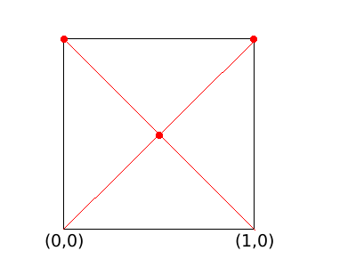
Example Continued
At each step, connect each number of S to the points below each left and right closest neighbors (in x-value)
Then add the intersections to S
Now, S = { (0,1), (1/2, 1/2), (1,1) }
The x-coordinates are the elements in F₂ = 0/1, 1/2, 1/1
Notes:
Picture 2

Slide 12
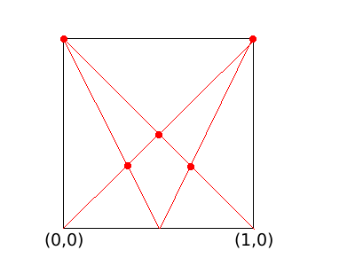
Example Continued
Continuing this process, the x-coordinates in F₃ = {0/1, 1/3, 1/2, 2/3, 1/1}
Notes:
Picture 3

Slide 13
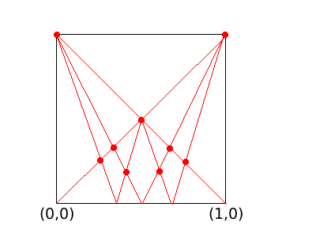
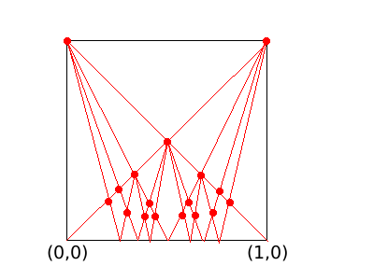
Example Continued
For n ≥ 4, we pickup fractions we don’t need until later sequences
Notes:
Pictures 4 and 5

Slide 14
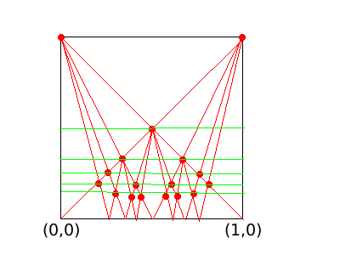
Example Continued
To discern between fractions in F_{n} and those we save for later, we use the heights of the points in S
Notes:
Picture 6

Slide 15
Example Continued
So F_{n} = { x-values of points in S where the y-value is one of the nth highest possible values }
In the example on the right is displayed F₆
We did not include the extra four points
Notes:
Repeat picture 6

Slide 16
The Second Geometric Construction
The second construction comes from Ford Circles which were studied by Appollonius & Descartes and first written about by Lester Ford, Sr.

Slide 17
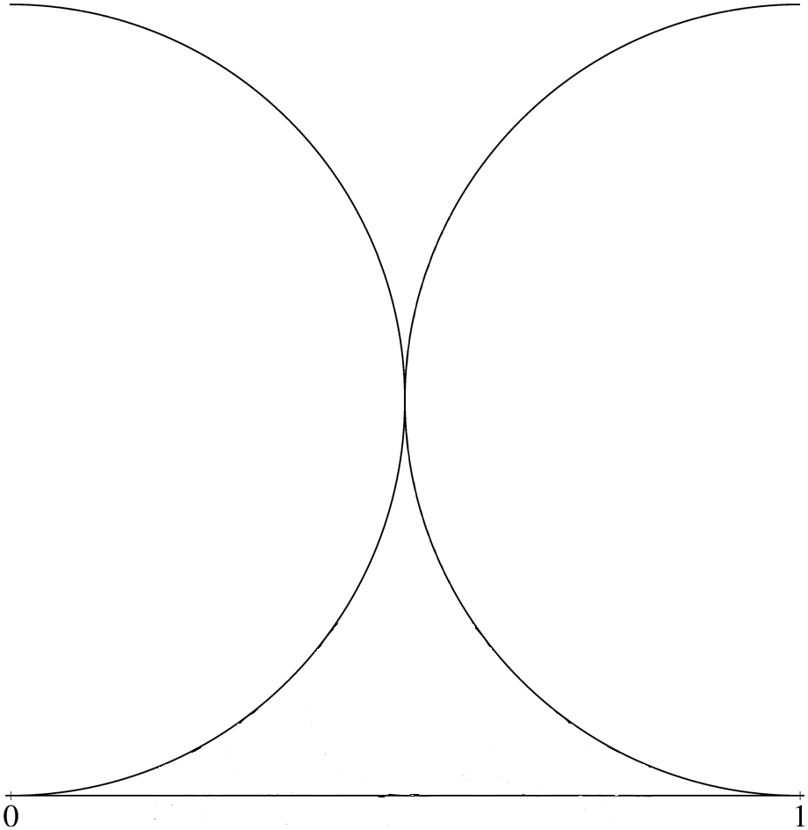
The Construction of Ford Circles
Start with the segment connecting (0,0) and (1,0) and place on top of both endpoints a circle with radius 1/2.
Notes:
Largest possible circles one could place there before they begin to intersect

Slide 18
Construction of Ford Circles Continued
At each step, fill in the gap with the largest possible circle you can fit tangent to the number line
If there is a tie for multiple places where this circle can fit, you put all of the circles that tied in

Slide 19
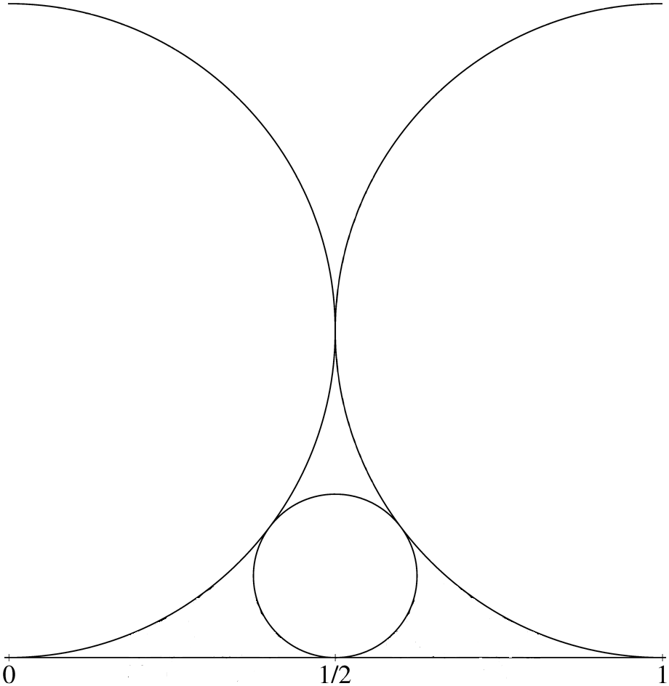
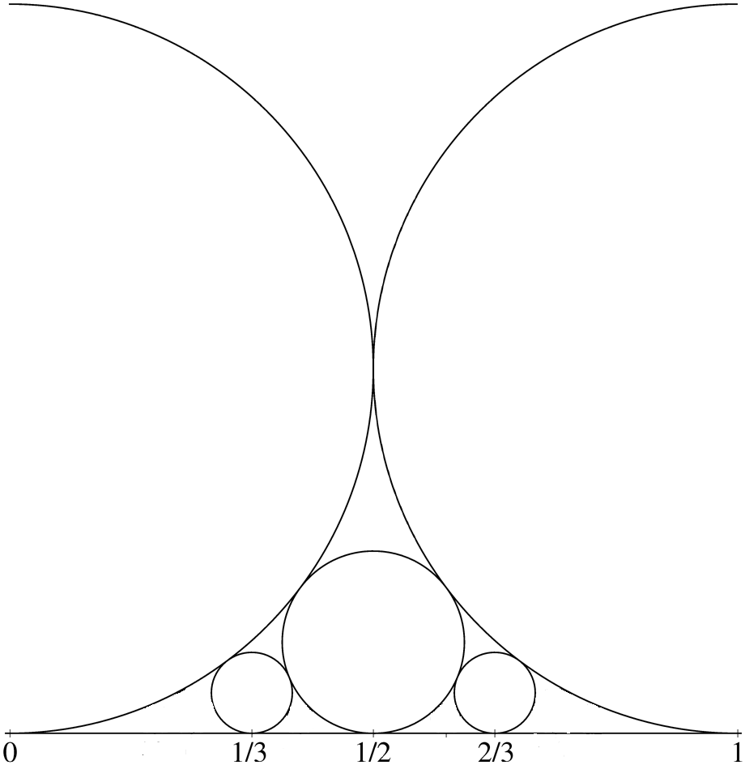
Construction of Ford Circles Continued
Step 2
Step 3

Slide 20
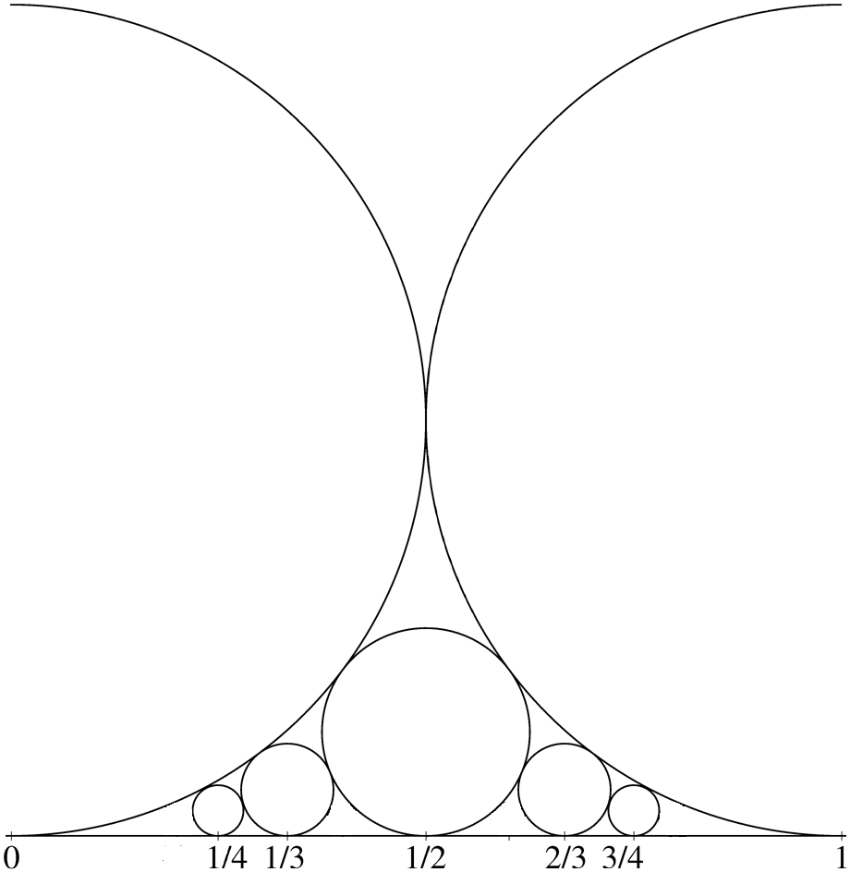
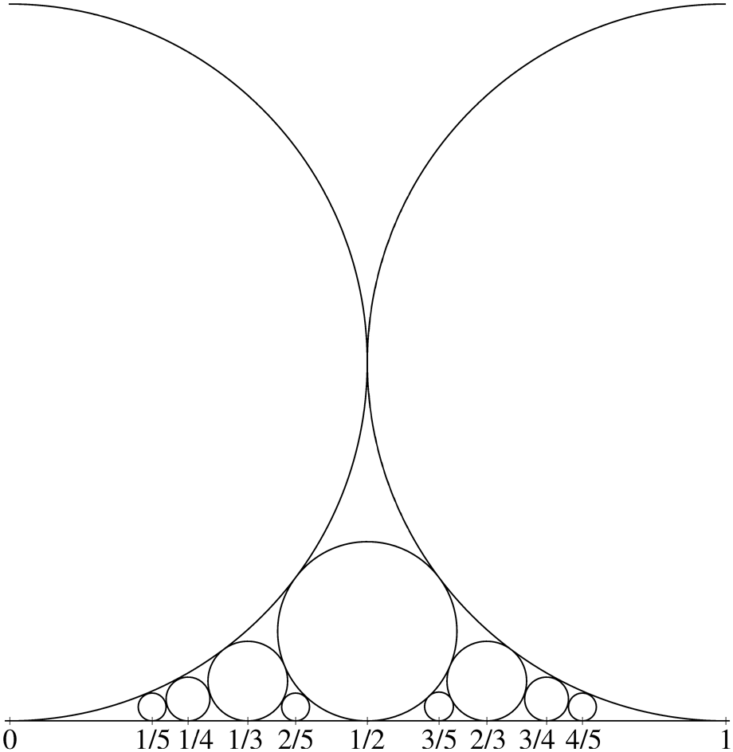
Construction of Ford Circles Continued
Step 4
Step 5
Notes:
Step 4 – two way tie
Step 5 – four way tie, all get placed in

Slide 21
How to Extract the Farey Sequences
F_{n} can be extracted from the nth step by looking at the coordinates of the points where every circle touches the number line
There is an obvious advantage to this construction, that you don’t get extra fractions in the nth step that you need to throw away to construct F_{n} (or save them for later if you’re constructing the sequence further)

Slide 22
An Interesting Equivalence
Let a_{k,n} be equal to the kth term in the nth Farey sequence
  For example, a_{2,5} is equal to 1/5 since F₅ is equal to {0/1, 1/5, 1/4, 1/3, 2/5, 1/2, 3/5, 2/3, 3/4, 4/5, 1/1}
Let m_{n} = |F_{n}|- 1
  (ex. m₅ = 10)
Let d_{k,n} be equal to a_{k,n} – k/m_{n}
Notes:
Ank is the kth term in the nth farey sequence

Slide 23
An Interesting Equivalence
You can think of Σd_{k,n} as how far F_{n} is from being equally distributed on the interval [0,1]
It has been hypothesized that the following two statements are true:

Slide 24
THE RIEMANN HYPOTHESIS!
An Interesting Equivalence
Neither of these equations have been proved yet
However, in 1924, Jerome Franel and Edmund Landau proved that both of these statements are equivalent to …

Slide 25
Thank you for listening!
Any questions?

