Slide 1
The Heat Equation: Fourier Series and Finite Difference Methods
Liban Mohamed

Slide 2
Outline
Mathematical Model
Fourier Series
Discretization
MATLAB Application

Slide 3
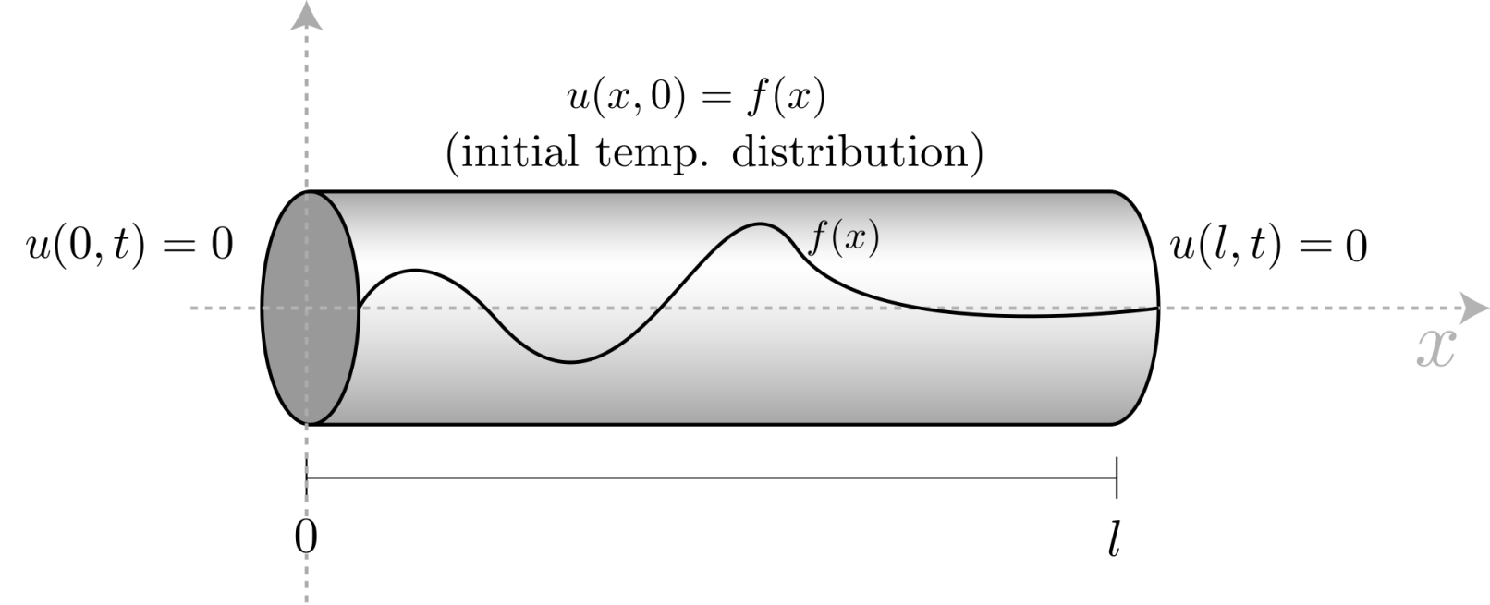
Mathematical Model
Rate of change of temperature is proportional to a constant multiple of the concavity of temperature.

Slide 4
Fourier Series
(1)Assume a solution of the form
u(x,t) = X(x)T(t)
(2) Plug into the heat equation
X”(x)T(t) = X(x)T’(t)
(3) Solve two ODEs
T’(t)+µT(t) =0
X”(x)+µX(x)=0
Solutions:
T_{n}(t) = C_{n}e^{-(nπ)2t}
X_{n}(x) = B_{n} sin nπx

Slide 5
Fourier Series(cont’d)
Using the initial condition, f(x) = sin(3πx), we see that n = 3 and b₃=1.
u(x,t) = e^{-(9π2)t} sin(3πx)

Slide 6
discretization
Forward difference quotient for time derivative
Centered difference quotient for spatial derivative

Slide 7
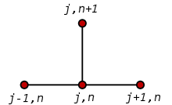
Discretization (cont’d)

Slide 8
MATLAB Application

Slide 9
MATLAB application(cont’d)

Slide 10
References
Stefan
Farlow, S. (1982). Partial Differential Equations For Scientists and Engineers. New York: Wiley.
Tveito, A., & Winther, R. (1998). Introduction to Partial Differential Equations A Computational Approach. New York: Springer.

