Slide 1
Generalized Linear Models (GLMs) and Their Applications

Slide 2
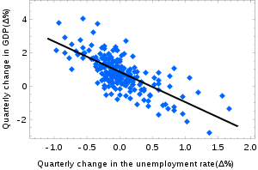
Motivation for GLMs
Predict values of a single dependent or response variable (Y) using several independent or explanatory variables
Treat Y as a random variable

Slide 3
Random Variables
A random variable Z maps outcomes of an experiment to the real numbers
Random Variables can be discrete or continuous and accordingly have a pmf or pdf
A pmf will always sum to 1 over all real numbers and a pdf will always integrate to 1 over all real numbers
Pmf’s and pdf’s are always nonnegative

Slide 4
Random Variables
Suppose p is a pdf/pmf and suppose the pdf/pmf of R is p(x) and the pdf/pmf of S is p(y). Then we say that R and S have the same distribution.
R and S are said to be independent if the probability of an event involving only R is unaffected by the occurrence of an event involving only S

Slide 5
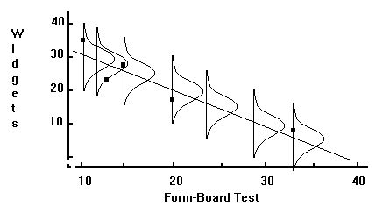
Simple Linear Regression (SLR)
Models a dependent or response variable (Y) based off of an independent or explanatory variable (X)
Creates a line running through a plot of data points
Y is random with a Normal distribution, X is fixed
Draw a sample of size n from a population, construct model using this sample
The ith observation has an X value of X_{i} and a Y value of Y_{i}
Independence of the Y_{i} ^{‘s}

Slide 6
Least Squares
Y_{i} = αX_{i} + β+e_{i} where e_{i} is a normal random variable representing error; thus Y_{i} is normally distributed by a property of normal random variables
SLR model has the form Ŷ_{i}= αX_{i} + β
Ŷ_{i} is the predicted or fitted value of Y_{i}, the actual observation
Least squares criterion: Choose α and β such that ∑(Y_{i}-(Ŷ_{i}))² = ∑(Y_{i}-αX_{i}-β)² is minimized
To find α and β, we differentiate ∑(Y_{i}-Ŷ_{i})² with respect to α and with respect to β and set both equations equal to 0
The α and β that satisfy the least squares criterion are unique

Slide 7
Example of SLR-Okun’s Law
Every 1% rise in unemployment causes GDP to fall about 2% below potential GDP(when all resources are fully utilized)
Change in GDP is Y, Change in unemployment rate is X
Following graph shows change in US GDP and US unemployment rate every quarter from 1947-2002, and fits a regression line through it
Every quarter is a data point, so the sample size is 220

Slide 8
Example of SLR-Okun’s Law
We can write Okun’s law as Ŷ_{i}=0.03-2X_{i} for the US
0.03 here means that at full employment (when X=0), GDP increases by 3% a year

Slide 9
Generalized Linear Models (GLM)
Y_{i}^{’s} are independent, from the same type of distribution but DON’T have the same parameters
Each Y_{i} is from the exponential family of distributions
μ is the vector of means of the Y_{i}^{’s} and has size n x 1
There is a function g(μ) where μ is a vector, g is invertible and g(μ)=Xβ
We use g to transform μ in such a way that we can estimate it using a linear combination of the explanatory variables

Slide 10
Generalized Linear Models (GLM)
g is called the link function and it depends on what we assume the response distribution is
If the response distribution is Normal, g is the identity function and our model will be μ=Xβ
This is the model for Multiple Linear Regression (MLR)
X is called the design matrix and has size n x p, so the sample size is n and there are p explanatory variables
β is the vector of parameters and has size p x 1
β can be estimated through using maximum likelihood functions

Slide 11
Example of GLM- Binary Variables and Logistic Regression
n independent variables, Y₁…Y_{n}, each of them have a binomial distribution
Binomial Distribution: Y_{i} represents the number of successes in n_{i} independent trials, the probability of success in each trial is π_{i}
Since π_{i} is a probability it has to be between 0 and 1
We can model π_{i} by using a function whose range is between 0 and 1

Slide 12
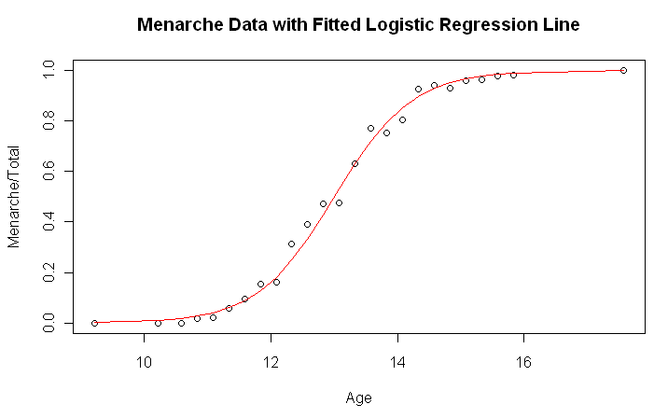
Example of GLM- Binary Variables and Logistic Regression
Example: the proportion of insects killed at varying dosages of a pesticide
Link function g is called logit function and is log(π_{i}/(1-π_{i}))

